Slide 1
Exploring dust exposure in the stone industry
Safe Work Australia
Insights Report
November 2018
ThinkPlace
Version 1.5

Slide 2
Authors
This report was prepared for Safe Work Australia by ThinkPlace Pty Ltd.
Disclaimer
While Safe Work Australia makes every effort to ensure information is accurate and up-to-date, Safe Work Australia does not provide any warranty regarding
the accuracy, currency or completeness of the information contained in this publication and will not be held liable for any loss, damage, cost or expense
incurred or arising by reason of any person using or relying on the information in this publication.
This publication may incorporate views or information from third parties, which do not necessarily reflect the views of Safe Work Australia. The inclusion of such
material does not indicate an endorsement of that material or a commitment to any particular course of action. The views in this publication should not be taken
to represent the views of Safe Work Australia unless otherwise expressly stated.
Creative Commons
This copyright work is licensed under a Creative Commons Attribution-Non-commercial 4.0 Australia licence. To view a copy of this licence, visit
creativecommons.org/licenses. In essence, you are free to copy, communicate and adapt the work for non-commercial purposes, as long as you attribute the
work to Safe Work Australia and abide by the other licence terms. Enquiries regarding the licence and any use of the report are welcome at:
Copyright Officer
Safe Work Australia
GPO Box 641 Canberra ACT 2601
Email: info@swa.gov.au
Important Notice
Safe Work Australia provides the information given in this document to improve public access to information about work health and safety information generally.
The vision of Safe Work Australia is Australian workplaces free from injury and disease. Its mission is to lead and coordinate national efforts to prevent
workplace death, injury and disease in Australia.

Slide 3
Foreword
Safe Work Australia engaged ThinkPlace to conduct rapid qualitative research into dust exposure from the manufacture and cutting of natural and composite stone benchtops. The research form is an ethnographic study to gain insights into the risks and behavioural factors which impact on the work health and safety (WHS) practices of manufacturers and installers of stone benchtops in Australia.
This report presents the approach and findings of the qualitative research into the manufacture and cutting of natural and composite stone in New South Wales, Victoria and the Australian Capital Territory. This industry has been identified as having high-risk work processes due to the inherent risk of exposure to airborne contaminants and the increasing prevalence of associated dust diseases.
The key insights outlined in this report may not necessarily be reflective of the broader industry. However, this research adds to the body of WHS evidence in the manufacture, cutting and installation of natural and composite stone benchtops and aligns with the findings of other research and industry concerns. This qualitative research provides detailed information about the views and behaviors of small businesses in the stone industry towards risk management and WHS in their work.
This report is intended to inform and stimulate a broader conversation around WHS in the stone industry, in particular the manufacture, cutting and installation of natural and composite stone benchtops and initiate further evidence and policy work to improve WHS outcomes for the industry.

Slide 4
The manufacture and installation of composite stone benchtops is booming around the world. This creates pressure on businesses and workers in the Australian stone industry.
Exposure to dust and hazardous chemicals is viewed as unavoidable to maintain a competitive business and the evolution of the industry appears to be impacting on safety measures.
The delay in some visible health impacts is creating uncertainty and concern around worker safety.

Slide 5
01
Key Insights
Presented below are the key insights from our research:
Dust exposure is viewed as an unavoidable part of the job with little clarity of safe options
What if… there were more practical tools that businesses saw as viable options to improve safety?
02
People are not prioritising their own health until they see the personal effect on others
What if… long term health consequences were more visible in the industry?
03
The dread of composite materials leaves a feeling that the industry has been overlooked
What if … there was more targeted practical and health information for small businesses in the stone industry to boost health and safety knowledge?
04
Personal health, safety and reasonable timelines are sacrificed under the pressure to
take on a job
What if … there was more information about the health hazards and managing specific workplace risks associated with working with natural and composite stone?
05
Learning and skills are being eroded, stone workers are no longer trained stonemasons
What if … communication with the industry acknowledged the industry evolution and influenced long term changes
in culture?
06
There is little practical guidance and influence in weighing up competing risks
What if … there was more information to help small businesses make decisions in terms of competing risks?
07
It can be costly and difficult to engage with the broader safety, support and
regulatory system
What if … there was better information for small business about who to talk with about protecting workers?

Slide 6
Project intent
01

Slide 7
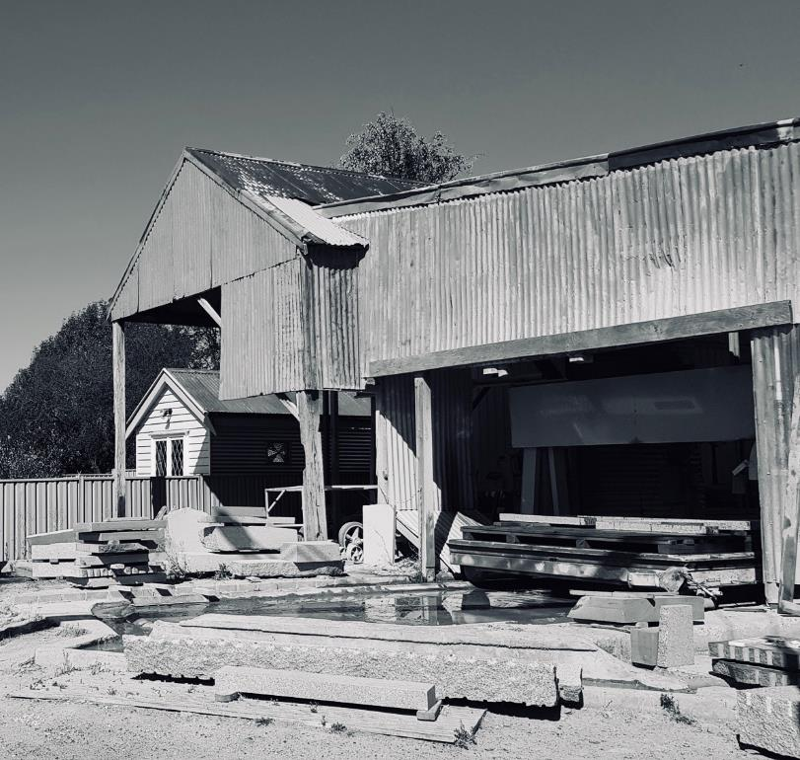
Context
Safe Work Australia contracted ThinkPlace to conduct rapid qualitative research into dust exposure from the manufacture and cutting of natural and composite stone to complement the existing data and provide a clearer picture of risk and behavioural factors.
The manufacture and cutting of natural and composite stone has been identified as a potential high-risk work process due to the inherent risks of exposure to airborne contaminants and the increasing prevalence of associated dust diseases, such as silicosis.
Our qualitative research was focussed on revealing behavioural and cultural insights, rather than quantitative and statistical measurements.
Why aren’t businesses identifying hazards and controlling risks relating to dust exposure, when information and interventions appear to be readily available?

Slide 8
Project timeline
This insights report is the result of a short, but intense sprint of field research. The insights and research approach were co-designed with a core-design team (CDT) from Safe Work Australia. Each step below represents approximately one week.
1
2
3
4
5
Intent | Research | Form insights | Validate | Finalise
Understand intent and build the project plan with the CDT | Research protocol, fieldwork and desktop research. | Workshop with SWA CDT to generate insights | Validate insights and prepare report. | Revise report. Submission to SWA Members.
Hey, what’s with the squiggle?
The Design Squiggle, by Damien Newman, is a way to convey the uncertainty and eventual clarity of the design process.
This insights report is the result of many wrong hypotheses, dead ends and deep questioning -- and it won’t be the last kink in the chain.

Slide 9
Our field work
We undertook field research in March and April 2018, interviewing small businesses with direct exposure to relevant risks. We focused on different cohorts of people, exposed to slightly different workplace risks, but followed a similar line of enquiry to expose influences on risk-managing behaviour.
Environment - context
Information and messaging
Perceptions and mental models
Behaviours and actions
What is the daily working context?
How does this influence how people identify/eliminate hazards and manage/control risks?
Where do people get information about identifying and eliminating hazards, and managing and controlling risks?
How do people think about hazards and risks?
What are they aware of?
What are people doing to identify hazards and manage risks?
Why are they taking a particular course of action?
How are people using (or not) what’s available in their work context to help them identify hazards and manage risks?
What are people’s trusted relationships and sources of influence?
How do people prioritise different hazards and risks?
What factors affect the use of PPE and other tools and processes to identify hazards and manage risks?

Slide 10
Who did we speak to?
It was very difficult to find people willing to sacrifice an hour of their time, despite the fact we were paying for participation. Within Canberra, we only found two people willing to speak. Our other participants were recruited in Victoria and NSW.
It was obvious that many of the people we contacted were simply too busy to talk to us (see insight 4). There was also a clear reluctance to engage after we disclosed our funding source (see insight 7). Others expressed a lack of interest.
Through opportunity sampling and referrals by people within the industry, we managed to identify nine individuals. Each in their own way, represent an archetype, and a deeply connected voice for a particular part of the ecology. We also had a brief chat with a representative of a large distributor and supplier of composite stone. In addition we drove up to a number of distributors and suppliers in the suburbs of Melbourne, with limited success – although we did get some useful insights.
Archetype | Description
The Educator | Ex-stone-mason, now health and safety instructor
The Landscaper | Experienced stonemason overseeing stonelayers on site
The Carpenter | Started as a carpenter, switched to stonework ‘cutting rectangles’ on mostly commercial jobs, part-owns a stone business and oversees junior staff
The Small Business Owner | Started a stone business in the last few years, worked in the industry for a long time and in the process of acquiring Cert III in recognition of prior learning
The Master Mason & Business Owner | Certified stonemason, started a small business doing installations, after working in factories for 7 to 8 years
The Veteran | Certified stonemason with over 18 years experience in the trade, works installing benchtops
The Junior | Started stone cutting and installing only recently, background in joinery, worked in ‘sandstone’ for a while
The Old Guard | Grew up working in the quarry and with stone, working ‘the old-fashioned way by hand’, works at a stone supplier and workshop that now only deals in natural stone
The Artisanal | Master stonemason and business owner who works in housing restoration and monumental work in a bespoke workshop for open air stonemasonry, trains apprentices

Slide 11
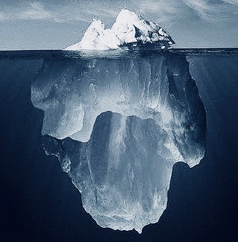
A word on our methods
To understand the whole system, we need to look at it in different ways… including below the surface.
We relied on agile, ethnographic research aimed at revealing deep insights in a short of period of time. Statistical research is like watching the scoreboard at a sporting game. It tells us what is happening and answers our question of ‘who’s winning?’. Our approach is more like watching the game itself, to know why the score is the way it is and how to improve the game. We may also need to look beyond the game itself. Our ethnographic methods complement other forms of knowing, and excel at providing a human context to more quantitative types of evidence.
Our methods are rigorous:
Our participant numbers will look very low compared to surveys, which require large numbers to have statistical power. Yet while we may only speak to a few participants to understand their experiences in more depth, we also engage with their entire community. We learn, test and iterate with people to validate our insights, rather than relying on numbers.
The power of ethnographic research is understanding people through empathy. While we do not remain ‘objective’ in scientific terms, our methods ensure we mitigate bias.
Our method is good for:
Understanding how systems operate in ‘real life’, rather than seeking to control or limit them.
Improving success towards strategic outcomes.
We are not:
Asking people what they want, giving them what they want, or expecting them to give us solutions.
Making assumptions about what people want, or validating a pre-determined solution.
Converting people to our way of thinking, acting, or seeing the world.

Slide 12
The systemic context
02

Slide 13
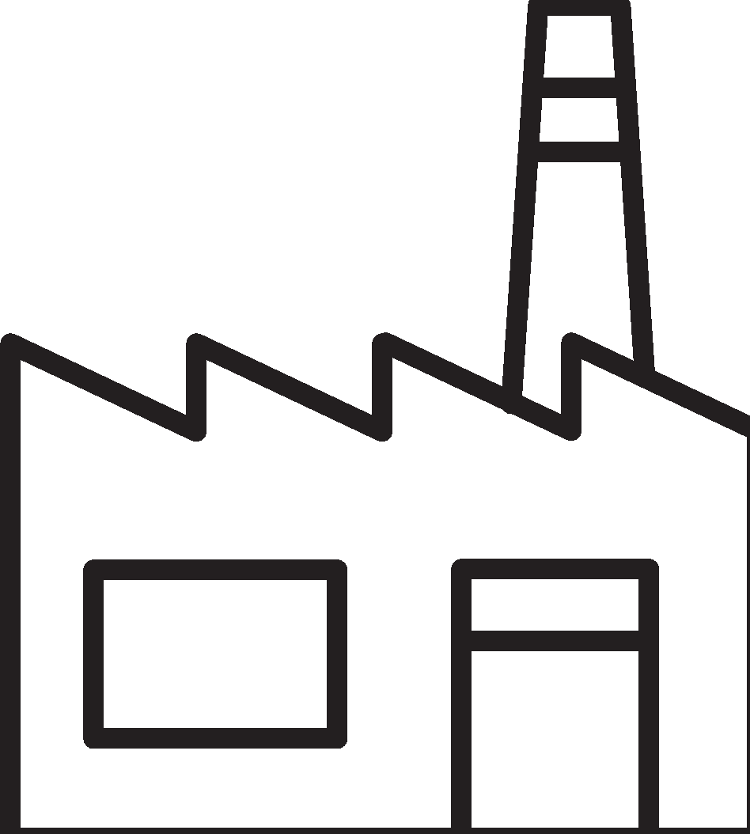
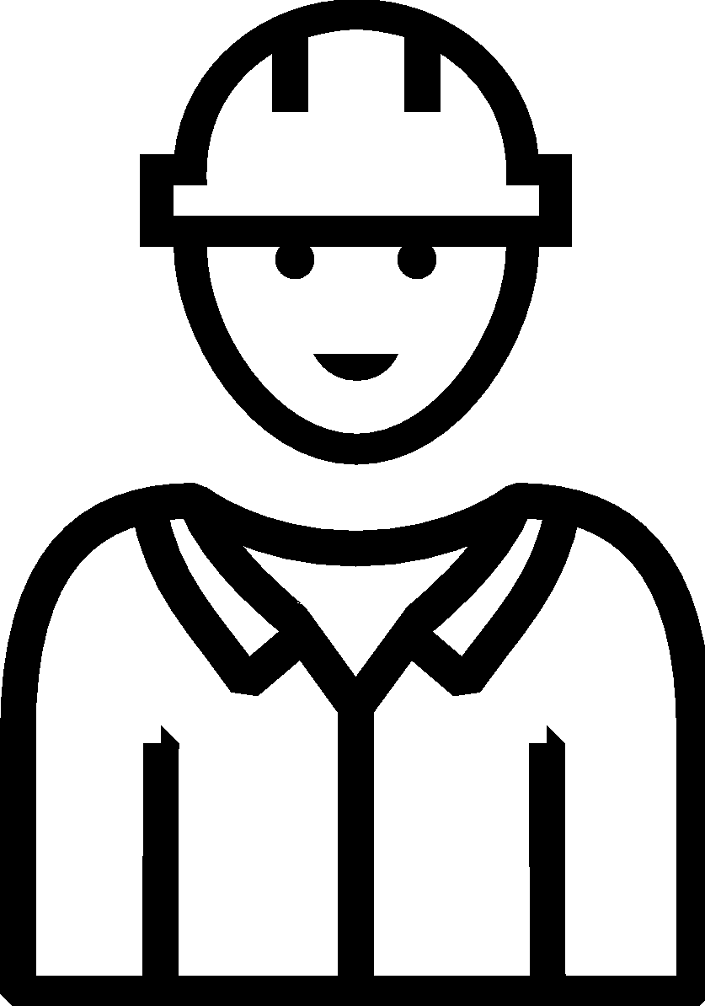

The pressures of the stone industry
The cost-benefit analysis that is intuitively made at each point in the system tends to underestimate the long term costs to health. It is biased towards short-term benefits in terms of immediate, visible safety and the financial rewards of finishing a job.
There is pressure from ‘the top-down’ in terms of profit-driven efficiencies, which has led to a devaluation of workers and those ‘lower’ in the hierarchy.
Commercial demand for new products
Commercial pressure to finish fit-outs quickly
Delivery of a profitable product
Government, regulators and insurers (e.g. WorkCover)
Consumers
Manufacturers and suppliers
Builders, kitchen-installers and other ‘customers’
Customers are more likely to go for the composite stones. It's not always obvious what constitutes ‘good stone’.
Some customers are picking up tools and installing composite stone benchtops themselves.
Maintain a profitable business and avoid injuries
Desire for secure income and ongoing health
Stone businesses
Glass cutters, cabinet makers, plumbers are cutting and handling stone. This occurs opportunistically, meaning people end up handling stone without any real background or knowledge about materials, hazards and risks.
Families and individuals
Other trades, now installing benchtops
Stonemasons are a dying breed, and with them a culture of prescriptive norms (culturally shared standards of working) around quality and safety. This increases the need for tailored information and education through the supply chain.
Contractors – usually ‘installers’
Workers in the stone industry
Norms about safety, often implicit, are communicated on worksites and through the industry.
Stonemasons

Slide 14
‘No one experiences the whole system: we experience pathways through it’
Prof. Richard Buchanan
This report unpacks the experiences of people working in the stone industry as they face the pressures of a broader system.
“
All the guy wanted from me was a paycheck, nothing about knowing and understanding the material
- D3 The Carpenter
“
I know perfectly competent people who don’t have licences [TAFE Certificates], because basically it seems like revenue raising, and I know incompetent people who do have licences
- D4 The Small Business Owner
Government, regulators and insurers
Consumers
Manufacturers and suppliers
“
Builders, kitchen-installers and other ‘customers’
It’s faster and easier to install, stronger and more flexible so it doesn’t break as easily – companies are pushing it, but it will only last 10 years, marble and granite would last 30 years
- D5 The Master Mason Business Owner
“
It’s everywhere, when you’re working you knock it up, the light shines through and you can see – just – fine particles, they’re very fine … you know there’re problems in the industry
- D6 The Veteran
Desire for secure income and ongoing health
Stone businesses
Families and individuals
“
Contractors – usually ‘installers’
Sometimes I hold a water bottle to keep the dust down, I wouldn’t use a mask then, generally [it’s] just the tradie cutting
- D7 The Junior
Workers in the stone industry
Stonemasons

Slide 15
The human experience
03

Slide 16
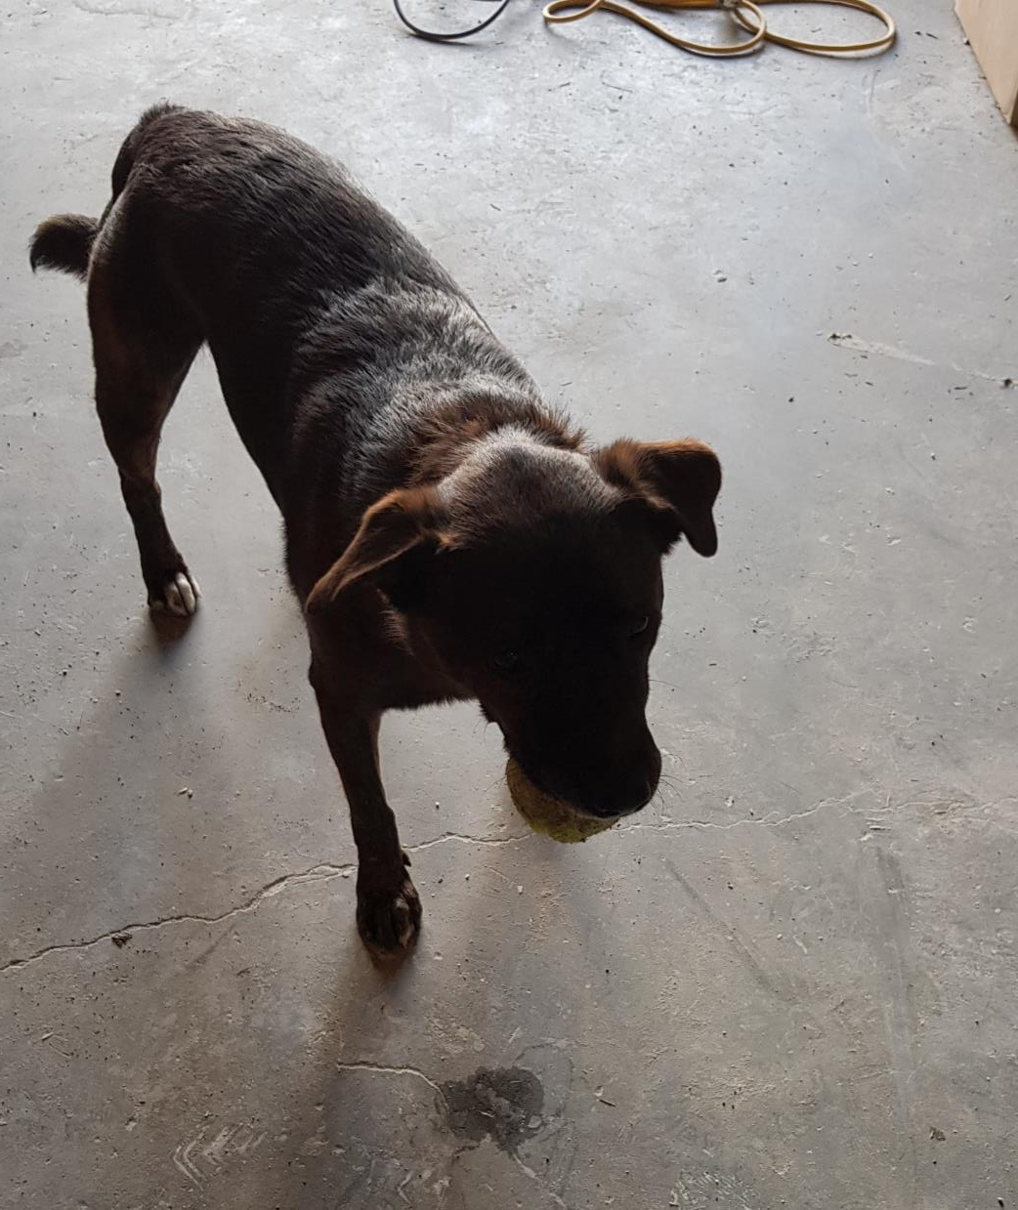
‘Our dog spends every day in our workshop.
Last year we had so much work we were sleeping here. We did 36 hour shifts, slept, got up and did more.
Then our dog developed a nasty cough, he's so close to the ground, kicking up dust all the time, imagine what it was doing to us.’
- D3 The Carpenter

Slide 17

01
Dust exposure is viewed as an unavoidable part of the job
“
There are just times you have to work with dust … even if you're wearing a mask you're covered in stone, it's in your car, your clothes, your hair, you can't avoid it
- D7 The Junior
Dust is everywhere and exposure is happening continuously and pervasively. The commonly regarded 'normal' baseline of expected dust in the worksite is still high. It’s seen as not only hard, but quite often practically impossible to get rid of it, even after leaving the worksite.
“
In my toolbox [in the workshop] I have a dust mask, and I keep disposable ones and ear plugs in the truck for on-site work
- D3 The Carpenter
Key insights
Installation is a key risk area, people are working without suitable PPE, and using hand held tools with limited wet-tools.
Stone workers aim to cut stone outside when installing on-site, but this is often unrealistic, leading to regular cross-exposure with other trades workers, who do not possess the adequate PPE.
Dust gets into clothing that is worn after leaving the work site. This can lead to re-exposure, when the clothes are brushed off. It can also introduce dust into other contexts, such as the home.
“
When you forget your mask you hold your breath and cut, walk away and breathe, come back and cut
- D6 The Veteran

Slide 18
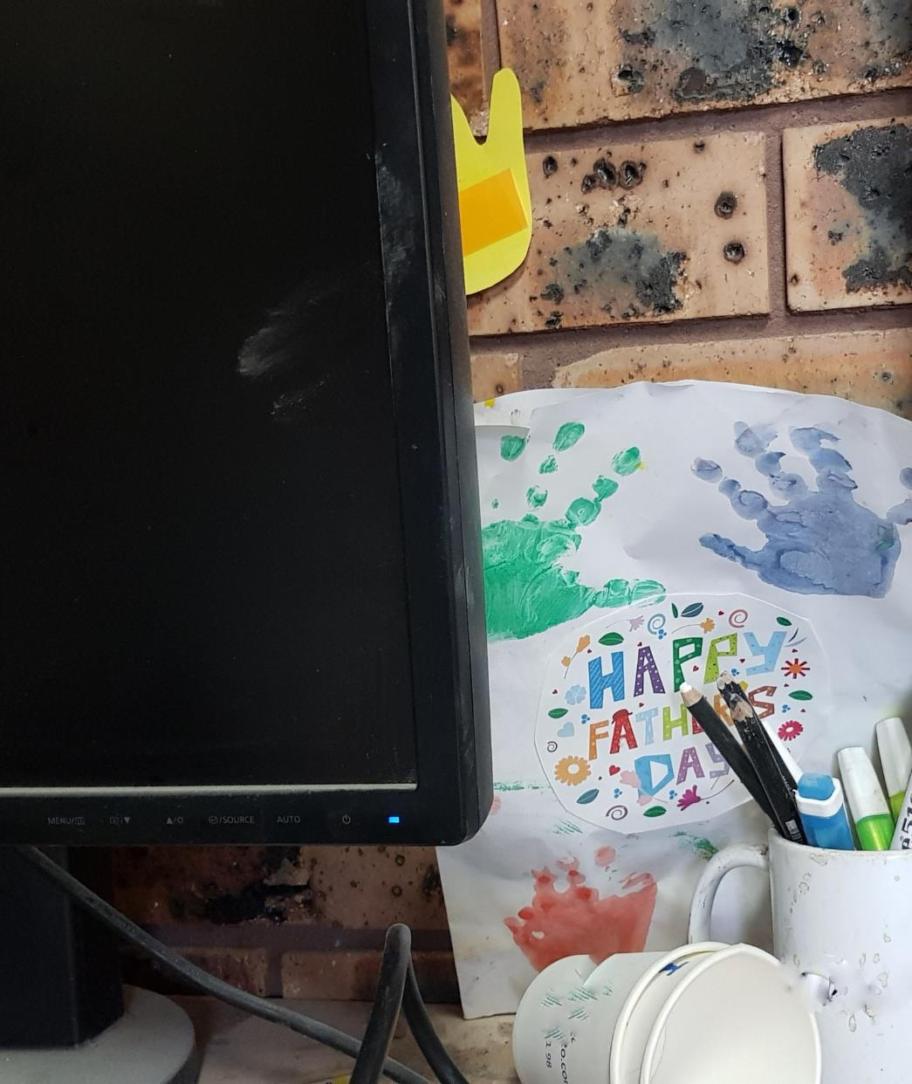
‘I hate dust, it gets everywhere, you see it's all over the office, it follows you home, you see it in your baby's hair.
We both had small girls a year ago, so we decided to stop doing dumb sh*t, not jeopardise going home at the end of the day.
But you can still be cavalier, if you're in a hurry you just start’
- D3 The Carpenter

Slide 19
02
People are de-prioritising their own health until they see the personal effect on others
“
You know you've f***ed up when you're driving home from a job and you're picking rocks out of your nose
- D3 The Carpenter
Long term health considerations rarely come into play, particularly for oneself. There is a lack of understanding of how one's own health is in fact an asset. Typically, concern only emerges when relevant others (partners, children, pets) are visibly affected by workplace dust.
“
Personal safety is the first to go … you think you're invincible
- D1 The Ex-Mason Educator
Key insights
“
There is no sense of personal identity outside of that of ‘worker’, ‘tradie’, ‘joiner’. As a result, there is no sense of self-worth, no inclination to truly take care of oneself – ‘it's part of the job’.
The culture of the work site often instils a sense of invincibility. It is only when relevant others, ‘less invincible’ people are affected, that awareness emerges.
Physical hazards loom larger than unseen and long-term abstract hazards like dust, seeing the exposure and effect on other people or dogs makes the intangible threat more real.
There’s a lot of heavy lifting and manual handling, a benchtop can be upwards of 200kg … you need to know how to lift
- D4 The Small Business Owner

Slide 20
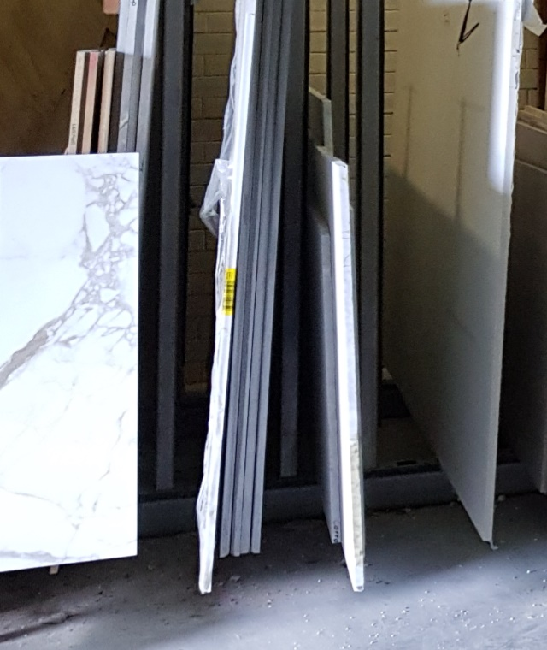
‘It’s not about if people will get ill, it’s when… because everyone is now working with these engineered stones.
For MDF you need to put a sign up, with stone you don't have to. There's nothing saying you're working with a hazardous material.
What's needed is more awareness, to know what you're working with.’
- D6 The Veteran

Slide 21
03
The dread of composite materials leaves a feeling that the industry has been overlooked
“
You know it's not good for you
- D4 The Small Business Owner
“
I think people are informing each other, are aware of the dangers, but nothing is done to improve the situation. No real effort is made to target the trade
- D3 The Carpenter
There is apprehension about the use of imported composite stone, which has largely replaced natural stone. They are seen as a ‘stronger slab’ than natural stone, with better resistance properties that require less technical skill to handle. For the industry, composite stone introduces efficiencies, such as shorter installation times and mass production of benchtop cut-outs. But they also appear to lead to the disappearance of skills, which in turn, appears to result in lower professional and safety standards and awareness of risk.
“
Key insights
The biggest issue is from composites … It is putrid … [they] were brought into Australia real cheap … we no longer work with composites
- D8 The Old Guard
Almost everyone we talked to had the sense that people in the industry are being exposed to potentially harmful gases and vapours, but that the effects will only reveal themselves when it's too late.
The lack of ‘visible’ regulation or penalties creates the impression that ‘no one cares’ and that everything goes.
There is a lack of targeted practical and health information about the risks of working with natural and composite stone in the industry.
The pervasive fear of the unknown impact of vapours released when working on composite stone appears to drown out other concerns, perhaps leading to a more relaxed approach to other hazards.

Slide 22
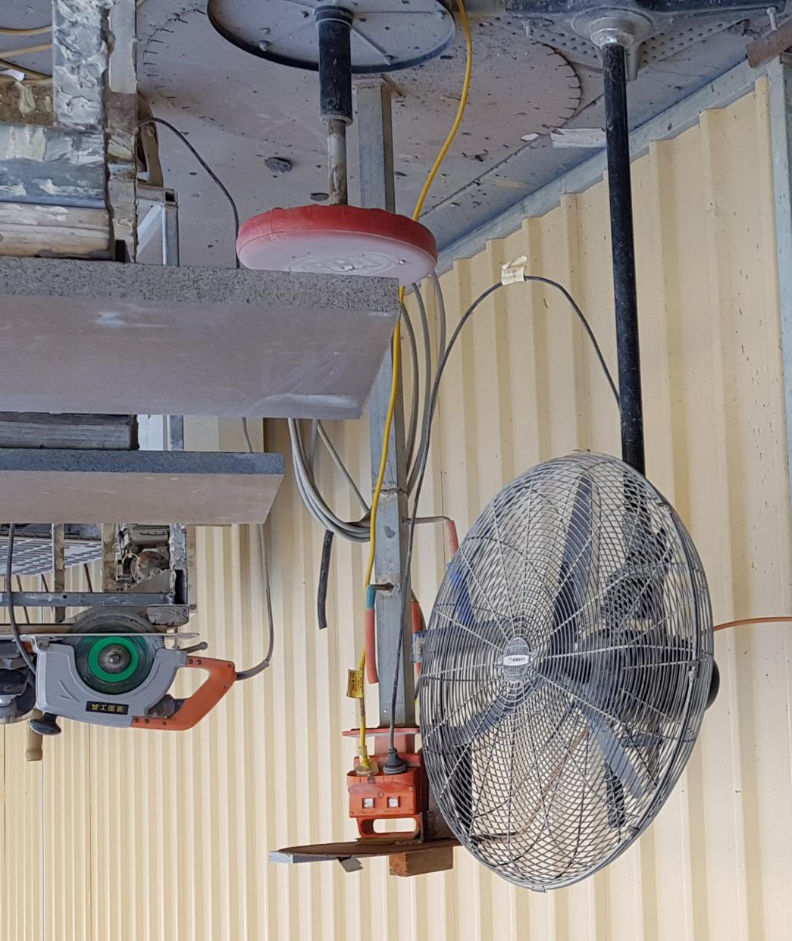
‘For the first few years [of your business] you're scared to stand up for yourself, you don't want to p*** off the builder. You're facing tight deadlines, the start date is delayed, but you're still expected to meet the same deadline, especially with commercial work. That's when you start cutting corners, both safety and quality.
You can't delay, they don't like it, everyone is trying to get their bit finished, it's costing everyone money if you go over.
If you make their life difficult they won't use you again.’
- D3 The Carpenter

Slide 23
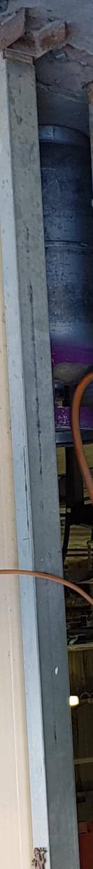
04
Personal health, safety and reasonable timelines are sacrificed under the pressure to take on a job
“
OHS is on the individual … I know it's [dust] not good for me, but it's up to me to put it [mask] on and when I'm focussed on a job to do I just need to get it done … when you're in a hurry you're generally doing something silly
- D3 The Carpenter
There are many small businesses with little redundancy in their operations. They often feel strong pressure to ‘take the job’, and rush through a high number of jobs. They are in no position to turn down jobs, or negotiate about the conditions in which they take place.
“
The trouble is the stone changes colour when wet, so you have to wait until it’s dry to see the finish, so at the end of a job you’re minimising the wet work so you can get out quicker
– D4 The Small Business Owner
Key insights
The value proposition of ‘health’ is not part of the efficiency equation.
Getting the job done is far more important than doing something in the right way.
Because so many different people can now install benchtops, there is a reluctance to say no to jobs – even when conditions are less than optimal.
The cost-benefit analyses that are made tend to underestimate the long term costs to health, and are biased towards short-term benefits in terms of immediate, visible safety and the financial rewards of finishing a job.
Due to the pressures that almost everyone we contacted was under, the response rate to our initial call for interviews was extremely low. They were simply too busy.

Slide 24
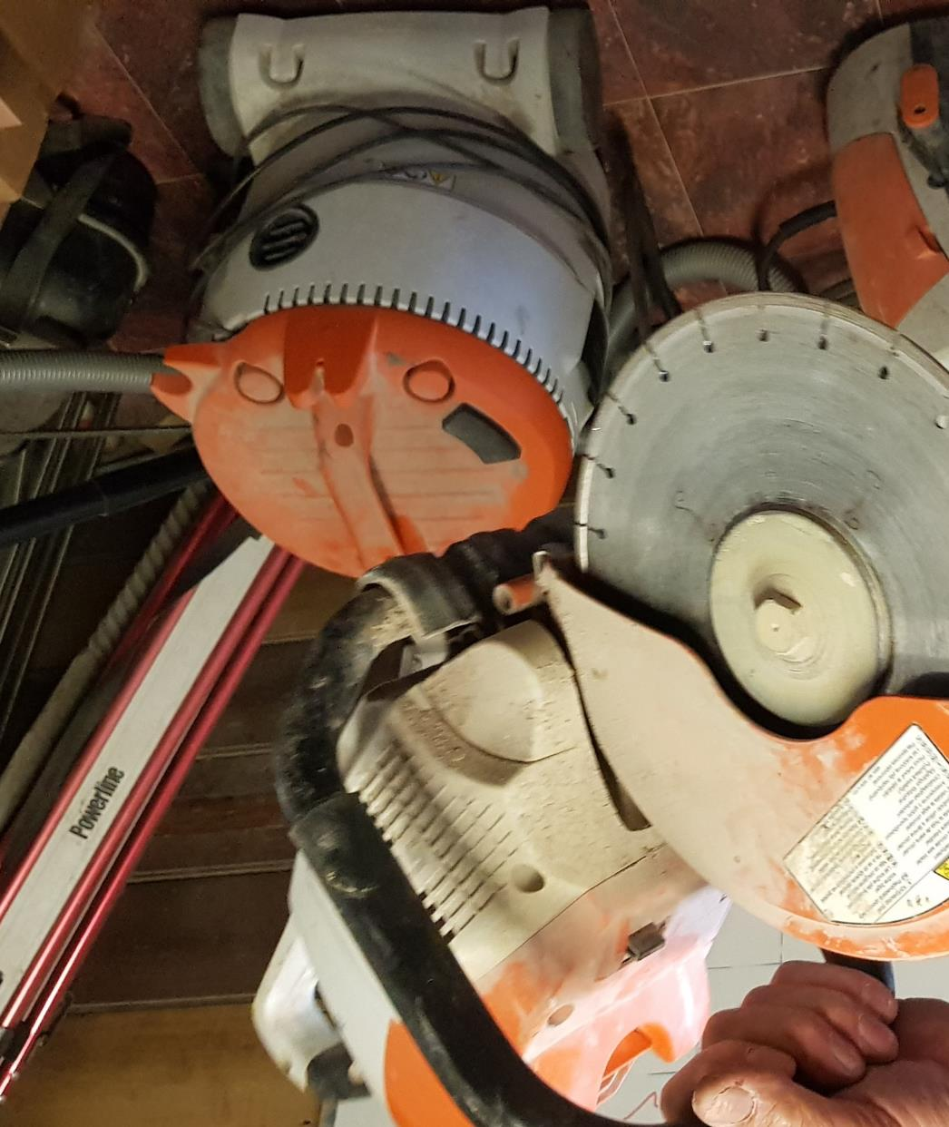
‘We're constantly being undercut, so we have to put out twice as much as before, the old square metre rate of a stonemason has reduced significantly.
People can come in and say they're installers, but they don't know as much. They don't know stonemasonry. Machines do it all in the factory, and because you don't need to know everything, they can charge less …
They've made it so easy any Tom, Dick and Harry can do it, they don't have dust masks, they wouldn't know about it. Many bosses would just say wear a dust mask, but that's not enough.’
- D5 The Master Mason Business Owner

Slide 25
05
Learning and skills are being eroded, stone workers are no longer trained stonemasons
“
I'm a trained cabinet maker .. I'm not "qualified" [stonemason], I'm sure I could get recognition of prior learning, I have a stone company, for f***'s sake. But what we do is not traditional, we cut rectangles
- D3 The Carpenter
Certified masons are a dying breed. Most of their work is now being done by other tradies that happen to end up doing the work. Although this might introduce efficiencies at some level of the system, it also leads to a loss of professional identity, complex skills and the often intuitive understanding of safety issues that emerges through deep experience with a trade.
“
We try to do most of our work in the factory, it’s where you do the best work and you have all the safe equipment, this means taking down a lot of dimension measurements, but being able to do that depends on the quality of the people measuring, some people just can’t do it
- D4 The Small Business Owner
Key insights
TAFE certificates and communication coming from government is seen to be largely out of step with the industry, as it is often still targeted at ‘stonemasons’ or ‘stone cutters’.
Getting the job done is far more important than doing something in the right way.
Training is linked to acquiring the skills to do the job, rather than skills to manage safety and risk.
People doing the installing aren’t necessarily stone trades – they can be carpenters, joiners, plumbers, home DIY people etc.
There appears to be a sense in the industry that ‘stonemasons’ have been left off the radar, and that they have not been supported in their trade. This has had a knock-on effect on the standards within the industry.
There is a lack of targeted practical and health information about the risks of working with natural and composite stone in the industry.
“
Our industry has been removed to India and China, 95% is now benchtops and tiling
- D9 The Artisanal

Slide 26
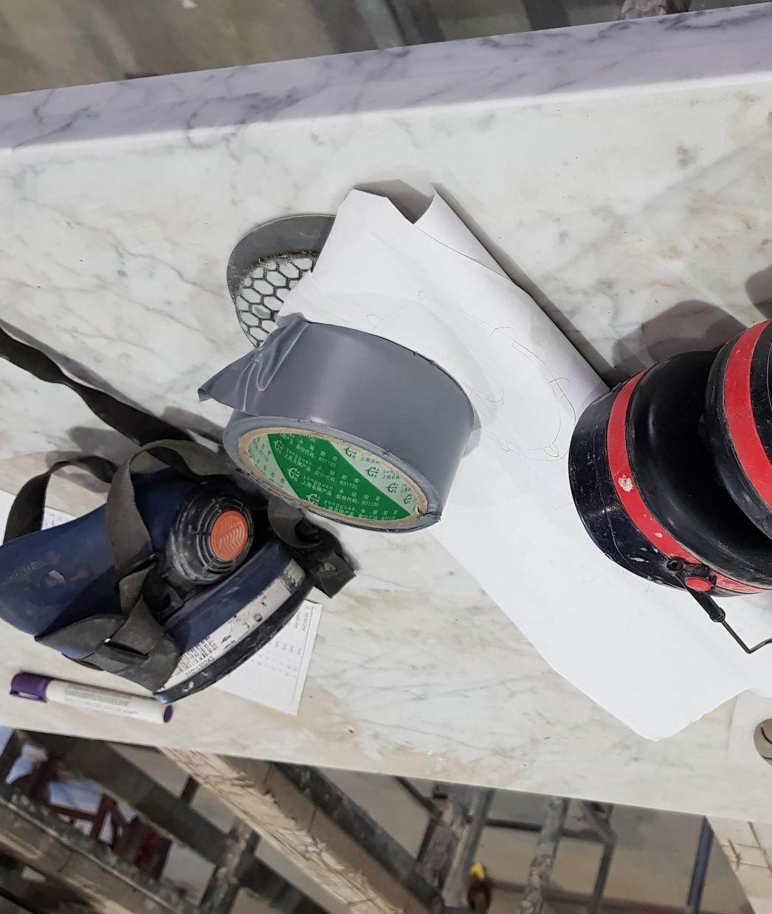
‘It's all well and good to put a mask on, but with goggles, the goggles start fogging up, if you have lots of cutting to do you end up taking your goggles off.
I'd rather see so I don't cut my hand off, and get stone in my eye. That happens every day. I deem it safer at the time.
I know the silly things I do are silly, but it's easier to do it this way, for me.’
- D3 The Carpenter

Slide 27
06
There's little practical guidance and influence in weighing up competing risks
“
If you can smell it you should be wearing a mask
- D7 The Junior
“
There are no easy to follow, practical guidelines to help make decisions in terms of competing risks. There is a sense that the choice is not between safe and unsafe, but rather between one option being somewhat less risky than another. How those decisions compound over time is unclear.
I take a common sense approach … I try to work outside, I try to minimise angle grinder work, I try to cut wet ... but with stone grinders you need to use them dry, it throws up a lot of dust – does it also cause silicosis?
- D9 The Artisanal
Key insights
There are no useful mental models of how efficiency and safety can go hand in hand. Instead they are often seen as incompatible parts of a zero-sum framework, with one going at the expense of the other.
Decisions are often not about eliminating hazards or managing risks in absolute terms, but more about which is the most acute, visible risk within a given context.
There is a lack of clear conceptualisations around ‘risk’ that can guide decision around what meaningful levels of acceptable risk are.
The housing construction industry usually involves different individuals and teams working on the same sites. Formulating and maintaining clear safety objectives in such a fluid environment is complex, and often ‘too hard’.
There is no ‘visible’ information available to the industry about the expectations of managing the risks of exposure from regulators and there is a perception that there is no information about how to protect workers from exposure to workplace dust.
“
You need to have your own procedures e.g. I stand upwind, but this doesn’t work in a unit or backyard ... e.g. take your overalls off, then get in to the car … these take a long time to learn
- D1 The Ex-Mason Educator

Slide 28
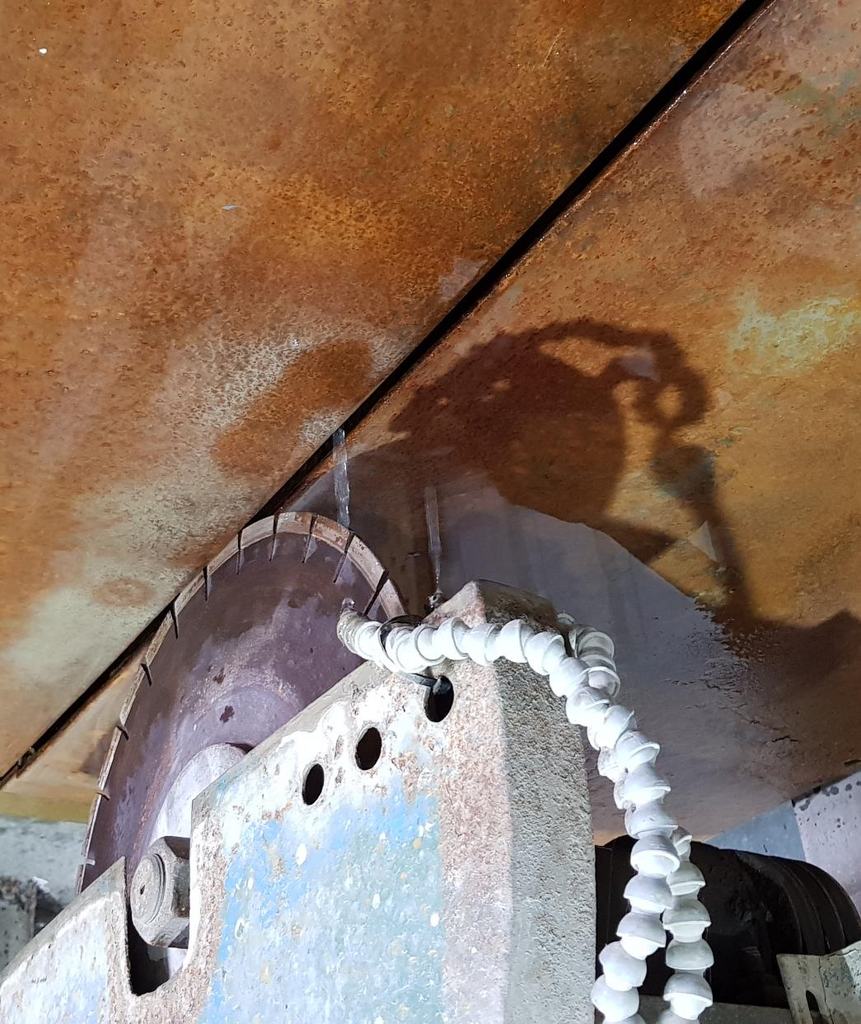
‘The only inspector I saw was from WorkCover, he came out and asked about my dust mask and how often the filters are changed.
I was [once] working for someone who only changed it every 6 months, it’s meant to be every 3 months, so I lied to cover for him.’
- D5 The Master Mason Business Owner

Slide 29
07
It can be costly and difficult to engage with the broader safety, support and regulatory system
“
We have SWMS, it's for the builder … they like to see it all signed off. It doesn’t change much between sites or jobs, last time I changed it was in 2013
- D2 The Landscaper
“
There appears to be a reluctance to make insurance claims or statements around safety, out of fear of the burden it could bring to small companies that are often already struggling with a lack of resources. As part of a vicious circle, that same perceived burden leads to a reluctance to hire additional staff.
It’s become a big impost on the business, aspirational Australians are scared … it’s destroying opportunities
- D8 The Old Guard
Key insights
“
The main source of safety messages and influences is incidental relationships or conversation in their own company, on site with the building manager, or with suppliers. The flow of safety norms through these interactions is crucial to shape behaviour, but is often limited to a consideration of liability.
The reluctance to engage with ‘the system’, or government, was also apparent in the difficulty we experienced arranging interviews – particularly after disclosing who was funding the research.
The paperwork generated by WorkCover, or dealing with tribunals, leads to an attitude of only hiring ‘trusted’ people. It reinforces stereotypes around trades from disadvantaged groups.
Safety forms, safe work method statements and safety data sheets are insignificant artefacts in the scheme of most workers’ days. It is quicker to fill out the required forms once then re-use the same ones over and over again.
Unless you're in a big company there's not going to be a union presence, not in the stone industry
- D5 The Master Mason Business Owner

Slide 30
Opportunity areas
04

Slide 31
Opportunities identified through our research
How might we improve the safe design of work across the stone industry?
How might we target awareness and education campaigns to businesses and workers in the stone industry?
Challenge | Opportunity
There’s uncertainty about identifying the hazard and managing the associated risk, not just what the hazard is. | What if people could identify the specific risks associated with composite stone? What if we could shift what people believe is an ‘acceptable’ level of dust?
There's little practical guidance and influence in weighing up competing risks, and the point at which a risk should be a major concern. | What if there was practical guidance to assist small business in the stone industry to make decisions about controlling the risks of dust exposure? What if there was greater promotion of dust mitigating technologies and useful resources? What if there was practical guidance for building site managers and other trades about controlling the risks of dust exposure during installation?
The cost-benefit analyses that are made by small businesses in the stone industry tend to underestimate the long term costs to health, and are biased towards short-term benefits in terms of immediate, visible safety and the financial rewards of finishing a job. | What if the long term health impacts were more visible in the industry? What if recommendations and guidelines were framed to compensate for people’s tendency to make choices for shorter term gains, while appealing to their desire to not lose their health over the longer term?
Informal peer-to-peer communication is a key source of norms (standard practices and behaviour), and blur the line between prescriptive (what is required by regulation and best practice) and descriptive norms (what people are actually doing). | What if messaging explicitly addressed current behaviours (e.g. tick box approach to risk assessment) and gave examples of how that behaviour should happen (e.g. risk assessments that lead to targeted communication between management and workers)?
There’s a loss of professional identity and associated norms around safety, which makes it hard to develop targeted communications. | What if targeted communication acknowledges the change in qualifications and experience in this industry? What if targeted communication influenced long term changes in culture and education to support the development of mastery, creativity, ownership and a sense of purpose?

