Slide 1

Exploring the experience of family farmers
Insights Report
Prepared for Safe Work Australia
April 2018
ThinkPlace
Version 1.2

Slide 2

Author and copyright information
Authors
This report was prepared for Safe Work Australia by ThinkPlace Pty Ltd.
Disclaimer
Safe Work Australia is an Australian Government statutory agency established in 2009. Safe Work Australia includes Members from the Commonwealth, and each state and territory, Members representing the interests of workers and Members representing the interests of employers.
Safe Work Australia works with the Commonwealth, state and territory governments to improve work health and safety and workers’ compensation arrangements. Safe Work Australia is a national policy body, not a regulator of work health and safety. The Commonwealth, states and territories have responsibility for regulating and enforcing work health and safety laws in their jurisdiction.
ISBN 978-1-76051-532-4 (PDF)
ISBN 978-1-76051-533-1 (PPTX)
Creative Commons
This copyright work is licensed under a Creative Commons Attribution-Noncommercial 4.0 International licence. To view a copy of this licence, visit creativecommons.org/licenses In essence, you are free to copy, communicate and adapt the work for non-commercial purposes, as long as you attribute the work to Safe Work Australia and abide by the other licence terms.
Contact information
Safe Work Australia | info@swa.gov.au | www.swa.gov.au
Important Notice
Safe Work Australia provides the information given in this document to improve public access to information about work health and safety information generally. The vision of Safe Work Australia is Australian workplaces free from injury and disease. Its mission is to lead and coordinate national efforts to prevent workplace death, injury and disease in Australia.

Slide 3
Foreword
Foreword
In 2018, Safe Work Australia engaged ThinkPlace Pty Ltd to undertake exploratory research to gain insights into the behavioural and cultural factors and barriers which impact on the work health and safety (WHS) practices of farmers. This report presents the approach and findings of the research, which involved in-depth ethnographic study of nine farms in southern New South Wales.
The small scale of the study and its focus on a specific sub-sector of the agriculture industry means the key insights outlined in this report may not necessarily be reflective of the broader industry. Nonetheless, the research adds to the body of WHS evidence in the industry and aligns with the findings of other research. As the research uses an in-depth approach, it offers detailed information about farmer attitudes and behaviours; helping to increase our understanding of the barriers to reducing the high rates of injuries and fatalities in the agriculture industry.
Rather than reporting on a stand-alone research project, this report is intended to inform and stimulate a broader conversation around WHS in the agriculture industry and initiate further evidence and policy work to improve WHS outcomes for the industry.

Slide 4
Despite massive change, there has not been substantial safety improvements on family farms.
Australian family farmers’ strong work ethic and ‘have-a-go’ culture makes our farmers uniquely entrepreneurial and productive while simultaneously putting them at high risk of injury and death.
Solving this means understanding the roots of farm culture and behaviour and designing different interventions that work to save lives.

Slide 5
01
Key Insights
Presented below are the key insights from our research.
Investments in safer equipment and practices are generally considered in the context of economic and efficiency gains.
What if… the benefits and consequences of safe practice were clearer and shown in economic terms rather than just in terms of individual safety?
1.1
Safety investments compete with productivity investments, as well as general family needs
1.2
Time pressures lead to fatigue and risky behaviour
1.3
Improvements in efficiency mean you can invest your time in other tasks, rather than shorter hours or safer work
02
When people change behaviour to adopt safe practices, it is usually based on ‘near-misses’, trial-and-error experience and local stories.
What if… safety messages were driven locally, co-designed by communities, with local stories and champions?
2.1
Farmers can be reactionary to personal health and danger, seeing incidents as unlucky rather than avoidable
2.2
Personal experience and local stories are a key driver of lasting behavioural change

Slide 6
Key insights
03
Farmers expect that contractors will take responsibility for their own safety, trusting that they have safer equipment and experience. This breaks down with low-skilled labour hire.
What if… the responsibility of care was clearer between farmers, contractors, sub-lessees, and labourers?
3.1
When contractors are employed, it is assumed that they also take on the risk involved in the work
3.2
Language barriers can impede efforts to provide a safe workplace
3.3
Farmers and contractors are unwilling to make demands of the other when it comes to safety
04
There is significant social norming of risky behaviour from an early age in farming families and communities, passed down through generations and across communities.
What if… we focus on teaching children safe behaviour, to break the norming of unsafe culture that happens at an early age, while also improving parents’ visibility of their own unsafe behaviour?
4.1
Farmers learn first from their parents and primarily learn through trying and doing, with little consideration of risk
4.2
Hazards and risks are inherited with the generational transfer of a farm business
4.3
Family farms do not have a clear line between home and workplace

Slide 7
Project intent
01

Slide 8
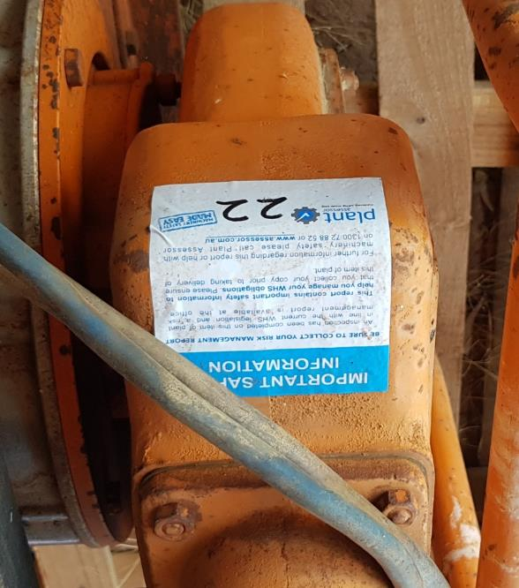
Context
Safe Work Australia contracted ThinkPlace to conduct rapid qualitative research into on-farm safety in the agriculture industry to complement its data to provide a clearer picture of risk and behavioural factors.
Under the Australian Work Health and Safety Strategy 2012-2022 agriculture was identified as a priority industry. Agriculture has the highest number of fatalities and second highest fatality rate of any industry. These rates have not shown significant improvement in recent years. SWA has also identified the use of quadbikes as a key risk/hazard requiring further investigation.
Our qualitative research was focussed on revealing behavioural and cultural insights, rather than quantitative and statistical measurements.
Why aren’t people identifying hazards and controlling risks on farms, when information and interventions appear to be readily available?

Slide 9
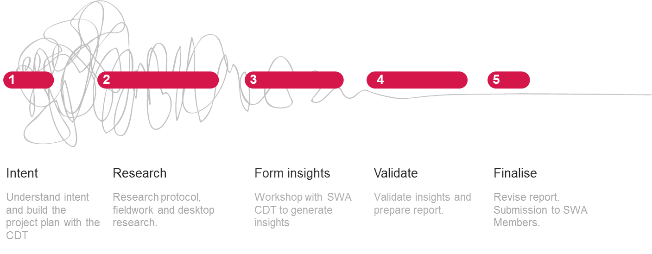
Project timeline
This insights report is the result of a short, but intense sprint of field research. The insights and research approach were co-designed with a core-design team (CDT) from Safe Work Australia. Each step below roughly represents one week.
Hey, what’s with the squiggle?
The Design Squiggle, by Damien Newman, is a way to convey the uncertainty and eventual clarity of the design process.
This insights report is the result of many wrong hypotheses, dead ends and deep questioning -- and it won’t be the last kink in the chain.

Slide 10
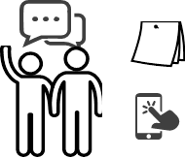

Our field work
We undertook field research in March and April 2018, interviewing people engaged in small scale farming, with direct exposure to relevant risks and hazards. We sought to make contact with people with as varied experiences as possible within the project’s scope.
Environment - context
Information and messaging
Perceptions and mental models
Behaviours and actions
What is the daily working context for people, and how does this influence how they identify/eliminate hazards and manage/control risks?
Where do people get information about identifying and eliminating hazards, and managing and controlling risks?
How do people think about hazards and risks? What are they aware of?
What are people doing to identify hazards and manage risks?
Why are they taking a particular course of action?
How are people using (or not) what’s available in their work context to help them control risks and hazards?
What are people’s trusted relationships and sources of influence?
How do people prioritise different hazards and risks?
What factors affect the use of PPE and other tools and processes to control hazards and risks?

Slide 11
Who did we speak to?
We spoke to people on nine different farms. Sometimes we spoke to families and contractors as well.
We recruited farmers primarily operating in NSW of different ages, who farmed different commodities and who had been farming for different lengths of time.
Through our recruitment we were able to engage with nine different primary farmers and in some cases their families. Each farmer we talked to represented a different archetype with differing perspectives, on their identity, their relationship to the land and their approach to operating their farm business.
We were also able to gain valuable insights from other family members, and from contractors.
Archetype | Description
“Retiring entrepreneur" | 60 years old, inherited the farm. Consolidating the farm to be able to do everything himself so he can retire soon.
“Retired wartime farmer” | 80 years old, retired 5 years ago. Has seen a lot of change.
“Passionate about safety” | 45 years old, with 26 year old son working the farm. Entrepreneurial, trying new techniques. Passionate about safety and concerned about labour hire.
“Father and son family farm” | Late 50s and son in mid 20s. Large, busy property. Whole family helps run the farm and farming is their life. Interviewed whole family, contractor and staff.
“Drought affected” | Mid 50s husband and wife. Had to get work in town to save the farm after the drought. Raising kids on the farm.
“There’s more to life than farming” | Mid 50s. Worked the farm alone, relying on contractors for big jobs. Would make time to have holidays.
“Set in his ways” | 60 years old. Working the farm in a shared arrangement with his brothers. Grew up working as a shearer. Still using much of his old equipment.
“Returned to farming” | Late 40s. Husband and wife returned to the land after years of off-farm work. Business-savvy with a work-life balance.
“My farm is a workplace” | Late 40s. Intentionally designed an organised and safe farm. Farmer has a contracting business on the side. The farm is a workplace.

Slide 12

A word on our methods
To understand the whole system, we need to look at it in different ways…including below the surface.
We rely on agile, ethnographic research aimed at revealing deep insights in a short of period of time. Statistical research is like watching the scoreboard at a sporting game. It tells us what is happening and answers our question of ‘who’s winning?’. Our approach is more like watching the game itself, to know why the score is the way it is and how to improve the game. We may also need to look beyond the game itself. Our ethnographic methods complement other forms of knowing, and excel at providing a human context to more quantitative types of evidence.
Our methods are rigorous
Our participant numbers will look very low compared to surveys, which require large numbers to have statistical power. Yet while we may only speak to a few participants to understand their experiences in more depth, we also look at their entire community context. We learn, test and iterate with people to validate our insights, rather than rely on numbers.
The power of ethnographic research is understanding people through empathy. While we do not remain ‘objective’ in scientific terms, our methods ensure we mitigate bias.
Our method is good for
Understanding how systems operate in ‘real life’, rather than seeking to control or limit them.
Improving success towards strategic outcomes
We are not
Asking people what they want, giving them what they want, or expecting them to give us solutions.
Making assumptions about what people want, or validating a pre-determined solution.
Converting people to our way of thinking, acting, or seeing the world.

Slide 13
The systemic context
02

Slide 14
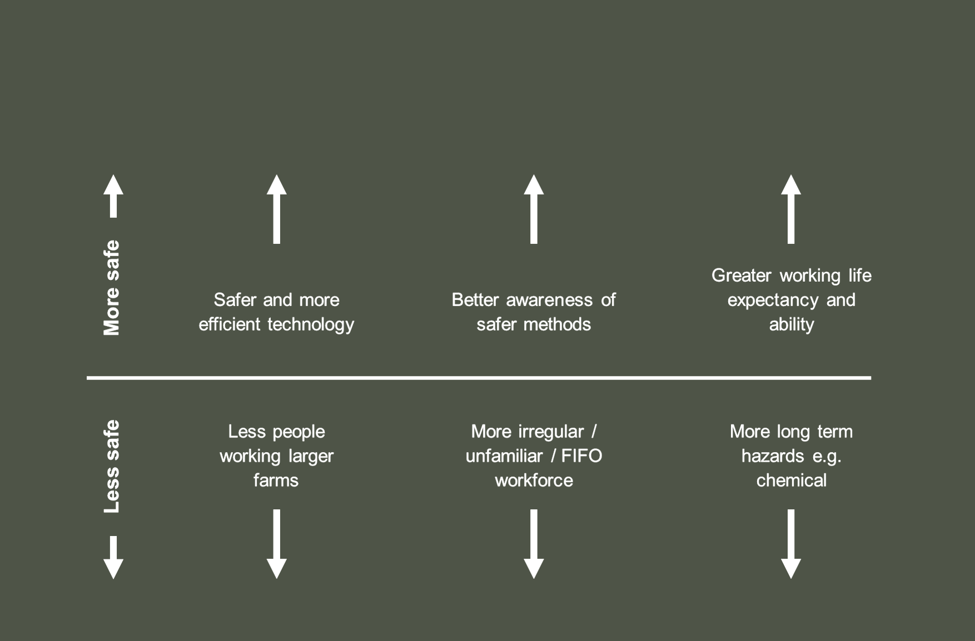
Why is safety not improving?
To understand how safety is and isn’t improving on farms we need to consider systemic changes and pressures that shape farming practices. Improvements in safety are counterbalanced by systemic pressures in other areas.

Slide 15
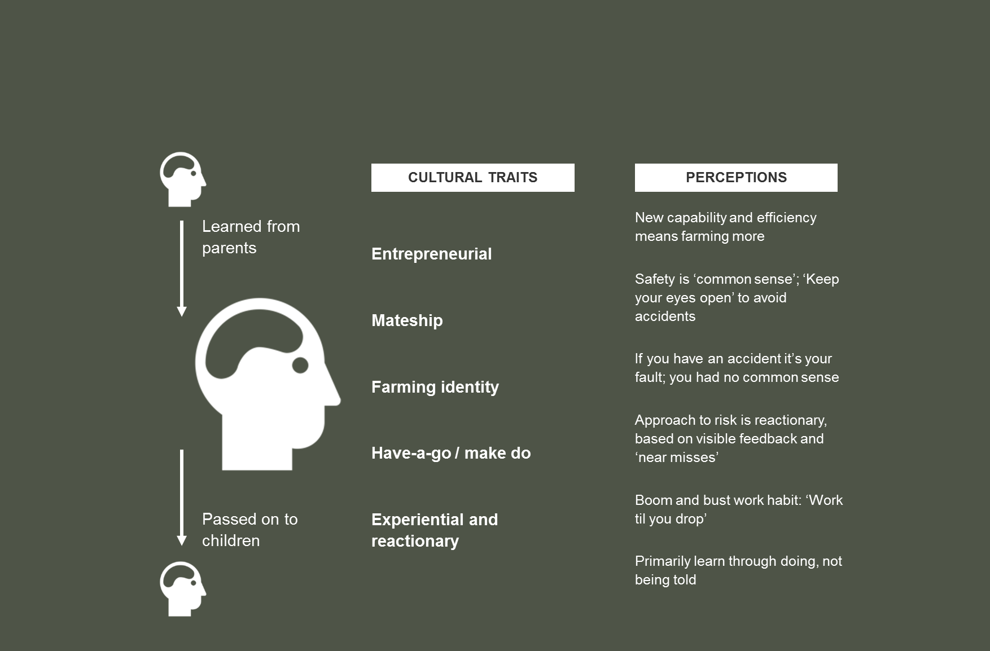
Culturally inherited values driving behaviour
Australian farming is a deeply cultural practice. Norms and behaviours around safety are influenced by culturally shared traits and perceptions. An understanding of safety is framed more naturally within this context.

Slide 16
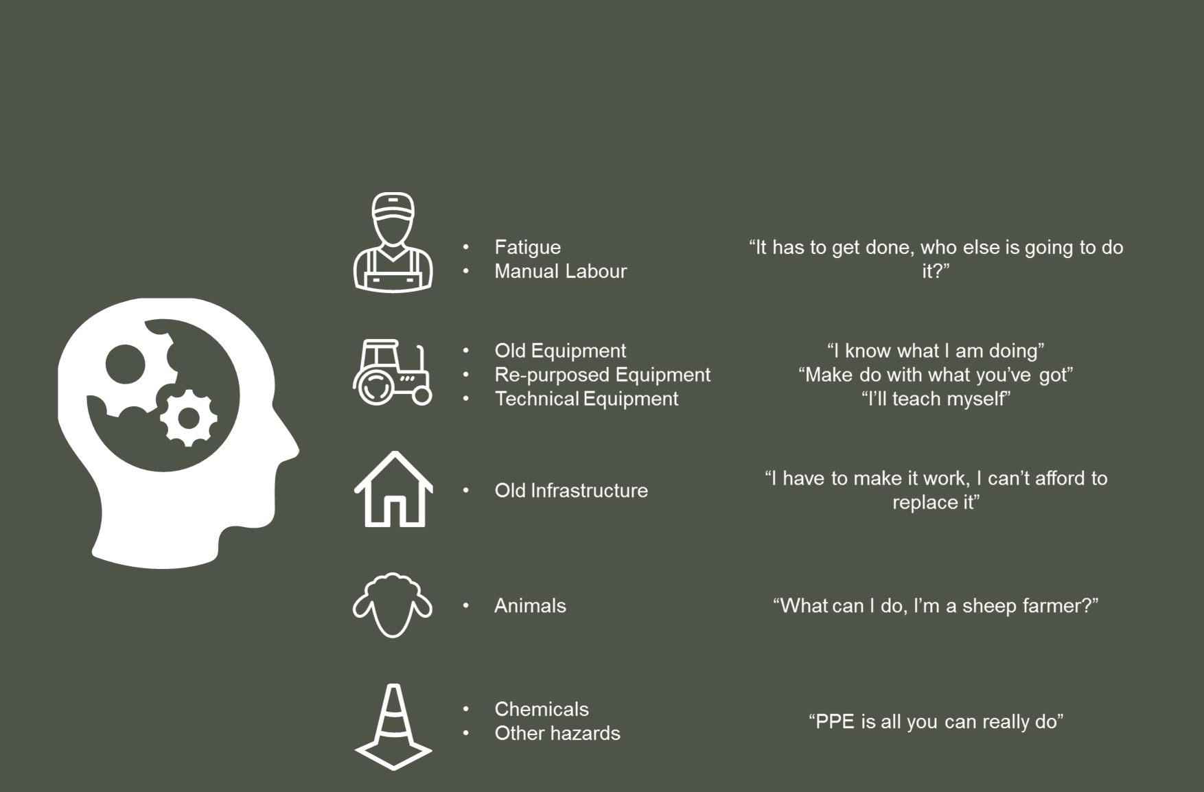
Mental model of hazards
A mental model reflects how someone thinks about the world around them. These associations can powerfully influence behaviour when identifying hazards and managing risks, especially when it is within the context of everyday work.

Slide 17
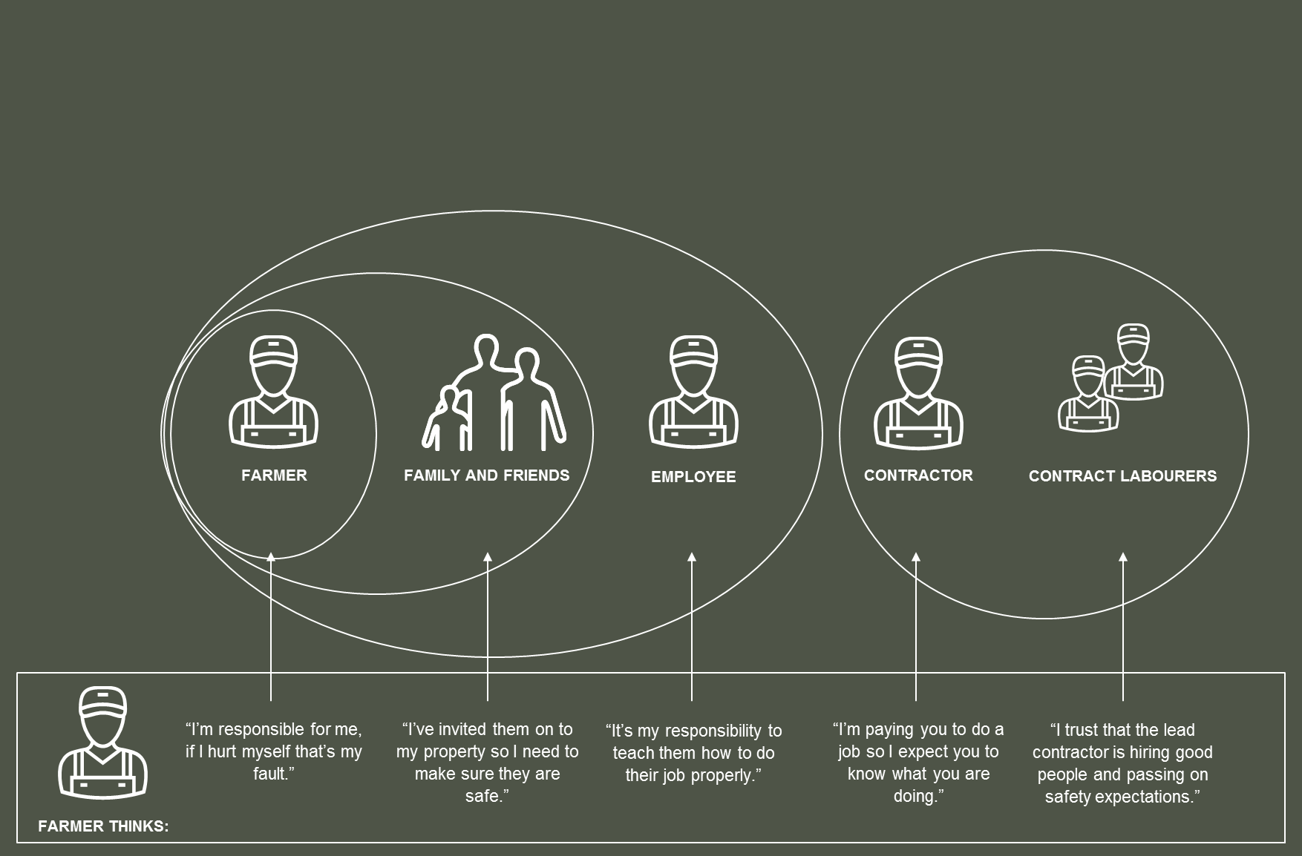
Farmers’ mental model of duty of care
A farmer’s consideration of a duty of care is centred around responsibility. The way that farmers think about where responsibility lies shapes communication about safety. Farmers view themselves as having some responsibility for the safety of family, friends and the training of employees, but limited responsibility for contractors’ work practices.

Slide 18
The human experience
03

Slide 19
The economics of safety
The economics of safety
Safer equipment and practices are generally considered in the context of economic and efficiency gains.

Slide 20
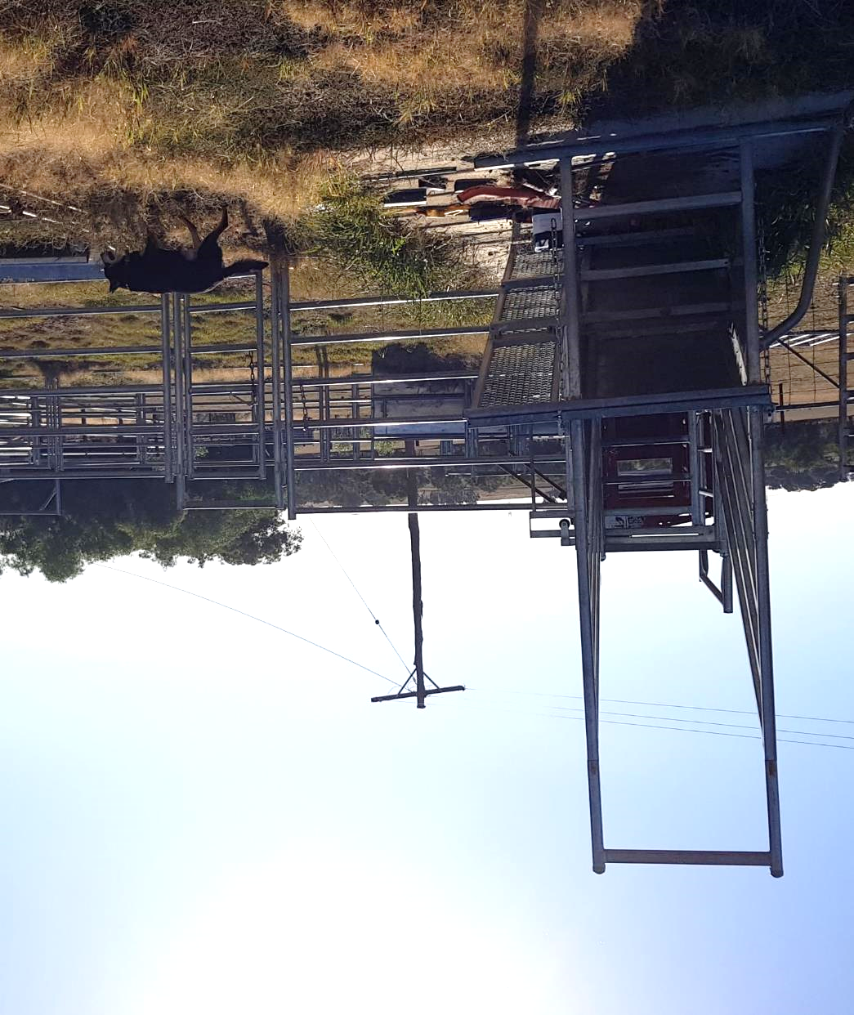
Quote from farmer
“We have six people using a bathroom that doesn’t work in a house with a roof that leaks. At the end of the day if we want to stay on the farm and work on the farm we need to live on the property so as much as those other [safety investments] would be great, I guess we will probably have to spend any money we have on the bathroom and the roof.”
Farm 5 ‘Drought affected’

Slide 21

1.1
Safety investments compete with productivity investments, as well as general family needs
“
The question is what is going to be the best benefit. Like, sowing is more important than fencing, as you can only do it when you have the moisture, got to sow, otherwise you won’t have a yield.
– Farm 3 ‘Passionate about safety’
Most farmers have an awareness of investments that would help manage risks on their properties and in their businesses. While in most cases, they have the intention to make these investments at some point, they often do not see these as immediate priorities as they consider other activities and investments, which more directly and tangibly improved productivity.
“
Everything you do is a risk, safety is bred into you but there is a financial block for safety.
– Farm 8 ‘Returned to farming’
Key insights
Farmers are aware of investments that would improve safety on-farm.
Farmers often see risk management as an additional benefit which flows from other investments e.g. the purchase of new equipment but the management of a risk is rarely the key driver of that investment.
Other factors such as weather can quickly change priorities to keep the farm business operating and/or to maximise profit.
The lack of distinction between the farm businesses’ resources and the owners’ resources means that more domestic priorities e.g. home improvements, family vehicles, holidays need to be considered when prioritising where investments should be made.
“
We really need a new family car, it has over 400,000 kms on it, but there is always something else to spend the money on.
– Farm 9 ‘My farm is a workplace’

Slide 22
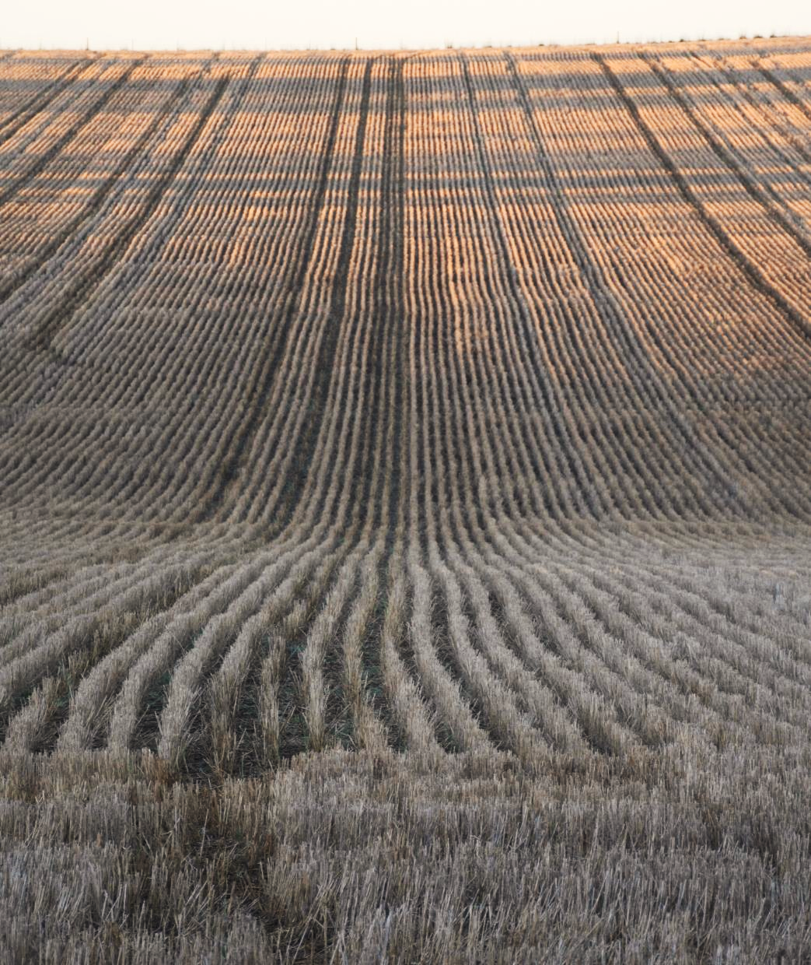
Quote from famer
“We had been harvesting for a couple of weeks and knew that a storm was on its way so we had to try and get as much harvested before the storm hit to stop our crop from being downgraded. I remember at one point when the rain had just started, we had been working for 36 hours straight. It was after midnight but we had to keep working because whatever grain we let get damaged by the rain would be downgraded and would end up costing us tens of thousands of dollars. I can’t remember exactly what happened but I think either my husband or I accidently swerved and almost took out the other vehicle, it was only at that point that we knew we had to call it a night.”
Farm 8 ‘Returned to farming’

Slide 23
1.2
Time pressures lead to fatigue and risky behaviour
“
At night time, s*** goes wrong.
– Farm 8 ‘Returned to farming’
“
Time pressures were regularly mentioned as having an impact on safe practices. These pressures are often outside of the farmer’s control, such as unpredictable weather conditions and the time-critical nature of key seasonal farming activities. These critical points set up situations that place extreme demands on farmers where safety is often compromised to get the job done.
You know when you are done, when you fall asleep at the wheel.
– Farm 9 ‘My farm is a workplace’
Key insights
“
My husband only had one weekend free, so he did a week’s worth of fencing in two days – now he has severe tennis elbow and can barely use his arm.
– Farm 5 ‘Drought affected’
During sowing and harvesting farmers have limited timeframes in which to maximise the quality and volume of their yield.
Most farmers’ average work days exceeded 10 hours, during harvest it would often exceed 18 hours with many farmers having had worked multiple days in a row without adequate breaks or sleep.
Farmers readily acknowledged the dangers of working under such extreme conditions but do not see any other viable option as delaying these activities could result in significant reductions in revenue.
The intermittent nature of intense periods makes it hard to employ extra hands, as they would not be busy at other times of the year and other farmers have the same busy periods.

Slide 24
1.3
Improvements in efficiency mean you can invest your time in other tasks, rather than shorter hours or safer work
“
It’s about efficiency, and efficiency doesn’t mean safety, sadly.
– Farm 4 ‘Father and son family farm’
Technology and other productivity enhancements have not reduced the workloads of farmers. Efficiencies are displaced by increases in property size and fewer people working regularly on the property. This leaves less redundancy for the farmer and an inability to take time off when sick or injured. They may also individually take on tasks that should be done by two or more people, as there are no spare hands to ask for help on the farm.
“
There’s always more tasks to do, you need to prioritise, and you’re going to prioritise tasks that link directly to income … other tasks will wait
– Farm 6 ‘There’s more to life than farming’
“
Key insights
The harder you work the better… we are trying to get him to take more holidays, slow down a bit, but it’s not easy. The more time you invest the more productive it will be, the more time you save the more you can increase productivity in some other way.
– Farm 4 ‘Father and son family farm’
Farms were previously low-tech, high-labour workplaces, they are now highly technical workplaces with few permanent employees and infrequent contractors.
Advances in technology mean the operation of a property that previously would have required a workforce of 10 or more people can now largely be done by one or two primary farmers.
The cost of equipment and other market forces has also resulted in larger, more diversified farms.
The drive to continue to grow the farm business has resulted in farmers seeking to minimise costs and therefore utilise their own labour wherever possible. This has resulted in farmers having to complete more varied tasks to work longer hours to get the job done.
The problem has been exacerbated by the lack of readily available on-farm labour and the lack of appropriate skills in those that are available i.e. seasonal, casual labour.

Slide 25
Learning and behaviour
Learning and behaviour
When people change behaviour to adopt safe practices, it is usually based on ‘near-misses’, trial-and-error experience and local stories.

Slide 26
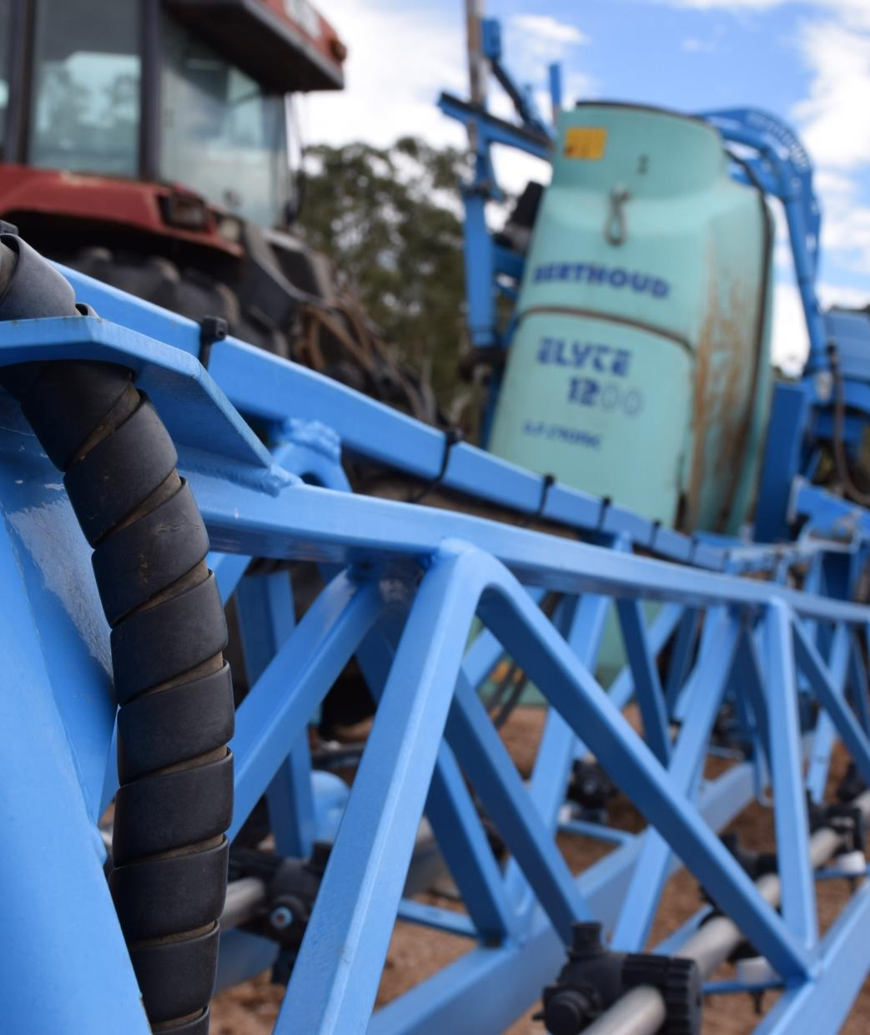
Quote from farm 5
“We needed a sprayer to help keep control of the weeds in the paddocks, we couldn’t afford a new one so we found a second hand one on Gumtree. We quickly realised why it was for sale. It leaked and whenever you used it you came off covered in chemicals. Chris kept on trying to use it, but he knew it wasn’t safe. Eventually it got to the point that he said ‘I can’t do that anymore, I can feel the chemicals on my skin’. So we had to take the little money we had and spent in on getting a contractor to do the spraying for us.”
Farm 5 ‘Drought affected’

Slide 27
2.1
Farmers can be reactionary to personal health and danger, seeing incidents as unlucky rather than avoidable
“
Until you’ve been in a position when you are in trouble, you don’t know what might give you trouble.
– Farm 2 ‘Retired wartime farmer’
“
Farmers only appreciate the value of their working health once it is gone. They may be aware of its importance to the ongoing productivity and profitability of the farm business, but do not consider risk management as part of a positive working culture and do not take adequate precautions to protect themselves. The economic value of future avoided injury is not front of mind.
A lot of safety, doesn’t get done, it just doesn’t suit the work. Like signage there’s only four of us, there’s not a strong argument just use common sense.
– Farm 4 ‘Father and son family farm’
Key insights
“
Ooh, we do some iffy stuff. The reason I do the iffy stuff is it has got to be done and it’s my responsibility, can’t get an employee to do it, you can’t always be 100% sure what you have done for safety will be enough, you’re only going on common sense, that’s what it comes back to, it’s the way you have been brought up to think about it.
– Farm 4 ‘Father and son family farm’
Farmers will often continue to work even when exhausted or physically injured buoyed by the drive to “get the job done” and to make the farm business as productive and profitable as possible.
Farmers appear to see the productivity and profitability as only limited by the hours in the day and their ability to work as many hours as possible.
The tangible side of safety predominates, such as signs, goggles, and guards, rather than the intangible process of planning and designing work to be safe.
Farmers think about planning their work in terms of common sense and aren’t conducting hazard identification processes before starting work.

Slide 28
2.2
Personal experience and local stories are a key driver of lasting behavioural change
“
A mate ran over his kid with his truck, it put the fear of god into everyone around here, everyone spent 2-3 years looking around.
– Farm 6 ‘There’s more to life than farming’
Farmers are more conscious of the on-farm safety and wellbeing of their family members and friends. Negative experiences and stories of their broader community are strong drivers of changes in attitudes and behaviours.
“
I was using the band saw and a piece of metal almost hit me in the eye, now I know to wear glasses when I use it.
– Farm 4 ‘Father and son family farm’
Key insights
Farmers noted that direct and indirect experiences of injuries or deaths of others, particularly children, had driven changes in their own behaviour and on-farm practices.
Farmers encouraged family, friends and other visitors to wear safety equipment i.e. helmets or life jackets even when they don’t use them themselves.
Farmers were more cautious about the use of equipment like quadbikes by family and friends than contractors and employees.
“
One time I tipped the truck too far back, almost got crushed by the truck. That scared the hell out of me and my brother.
– Farm 6 ‘There’s more to life than farming’

Slide 29
Farm workers
Farm workers
Farmers expect that contractors will take responsibility for their own safety, trusting that they have safer equipment and experience. This breaks down with low-skilled labour hire.

Slide 30
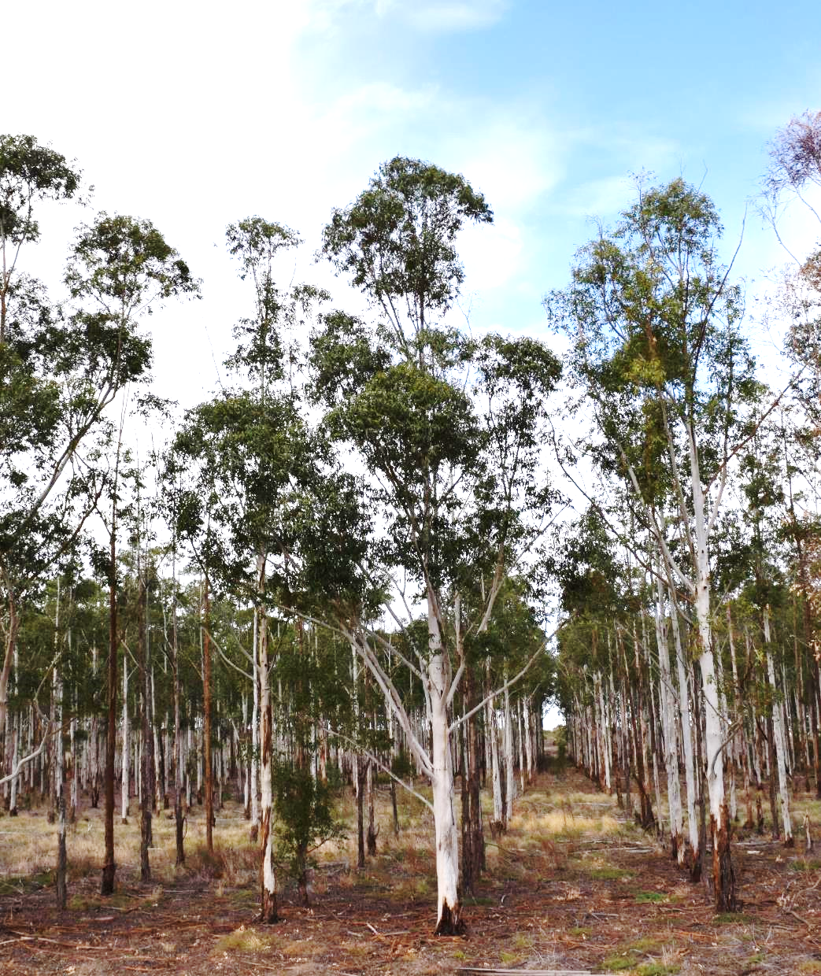
Quote from farm 7
“This year I decided to get a bloke in to to do some tree lopping because it’s too dangerous. He’s got all the gear, insurance, he looks after his own safety you know, like if it’s windy he doesn’t come in. It’s too much for me now, I would usually have gone up on a rope and done something stupid. Years ago, I would have done something like that myself, but not now that I’m getting older.”
Farm 7 ‘Set in his ways’

Slide 31
3.1
When contractors are employed, it is assumed that they also take on the risk involved in the work
“
The main thing about safety is to get the right people to do it, people I know and I know their past history. All the dumb ones are gone or gone broke.
– Farm 7 ‘Set in his ways’
Farmers engage contractors to complete tasks that require specialised equipment, specialised skills or to do work that the primary farmers are not able or comfortable doing from a safety perspective. Contractors are also engaged to do risky work as farmers believe they are responsible for their own safety.
“
For the really dangerous stuff, I found the best way is to get a contractor to do it.
– Farm 2 ‘Retired wartime farmer’
Key insights
“
Because of the specialised nature of the work, famers expected that contractors know what they were doing and would be doing it in a safe way.
Farmers see the payment of a contractor and the contractor’s higher rate (compared to an employee) as largely discharging the farmer’s duty of care to the contractor.
Farmers and those involved in the administration of the farm business also prefer contractors over employees as there is less associated administration e.g. calculating leave and superannuation entitlements.
There’s litigation and responsibility for employees, so I just do it myself…if I do something stupid, I get killed, that’s bad luck but I don’t want to be responsible for killing someone else.
– Farm 5 ‘Drought affected’

Slide 32
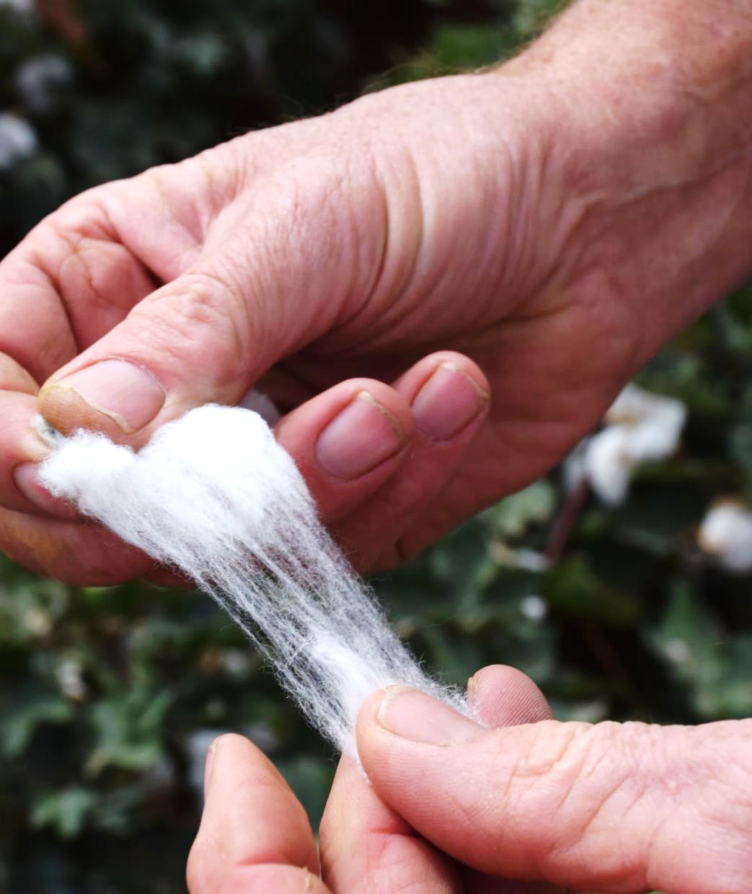
Quote from farm 3
“You can lay down all the instructions in the world. It doesn’t matter. Their English may not be terrific. Their ability may not be up there. Everybody thinks they can drive a tractor, but it’s not something they do on a daily basis, and they’re not familiar with your particular equipment.
I’ve got signs that say ‘10km/h’ and showing a mum holding a child’s hand. People don’t pay attention to them.
You’re trying to get them to understand that you’re providing a safe work environment. They don’t listen.”
Farm 3 ‘Passionate about safety’

Slide 33
3.2
Language barriers can impede efforts to provide a safe workplace
“
Labour is the problem, young people don’t listen as much, you tell them stuff, but they think they know what they are doing.
– Farm 6 ‘There’s more to life than farming’
Where farmers do attempt to provide induction or a safety briefing, there may be language barriers to understanding the briefing. In casual, seasonal and temporary workers (e.g. through labour hire), many do not speak English at all, and some have limited English. The language barrier increases risk associated with hazards of a specific farm or its equipment.
.
“
You can lay down all the instructions in the world, it doesn’t matter. You are trying to get them to understand that you are providing a safe work environment. They don’t listen.
– Farm 3 ‘Passionate about safety’
Key insights
Farmers often rely on the ‘lead contractor’ to transfer safety briefings and expectations to their sub-contractors.
A translation, e.g. by a co-worker or lead contractor, may not convey all of the nuances of the briefing that the farmer intends which leaves sub-contractors and others around them at risk.
Farmers stated that the experience and quality of workers varied greatly, with some groups being highly competent and others disengaged and potentially risky.
Farmers can get frustrated when workers assume they know how to operate machinery or equipment in a way that is against the farmer’s wishes and language barriers can exacerbate this problem.
The role of labour hire companies and lead contractors in providing adequate safety training is unclear, both for the job in general and for a specific farm.
Language further complicates legal situations as safety induction and training may be given but not understood.
“
Everyone thinks they can drive a tractor.
– Farm 3 ‘Passionate about safety’

Slide 34
3.3
Farmers and contractors are unwilling to make demands of the other when it comes to safety
“
You assume they know what they are doing, you are mindful of what they are doing, but you can’t send someone back once they are here, it’s a waste of time. We don’t have enough time to check if a contractor is doing the job right, just hope they know...we can’t be there saying you need to do it this way, each has their own way of doing it.
– Farm 4 ‘Father and son family farm’
The expectation that contractors are technical experts and “know what they are doing” limits farmers’ willingness to inform and/or critique contractors’ behaviour, especially in relation to safety on-farm. The view that a farmer has his own way of managing his farm creates reticence to impede on their domain and comment about a hazardous environment or risky practice.
.
“
Key insights
I wouldn’t feel comfortable putting [safety] signage up or telling them to wear PPE, I don’t want to offend them, they know what they are doing.
– Farm 8 ‘Returned to farming’
The farmers we talked to had only told a contractor to change their practices or to leave their property due to bad practices when it had involved the mistreatment of animals.
Only one farmer noted a time that a contractor had required changes to be made to make the workplace safer for the contractor and their sub-contractors to work at.
Contractors believe they are paid to do a job and to do it safely.
“
It’s up to them to maintain machinery, they have the latest and greatest header, so it isn’t going to catch on fire. I pay a fortune for it so they need to be efficient.
– Farm 6 ‘There’s more to life than farming’

Slide 35
Intergenerational learning
Intergenerational learning
The appropriate level of risk on farms is learned from a young age. Farms are built around existing layouts and achieving efficiency, with incremental change that makes safety difficult to retrofit.

Slide 36
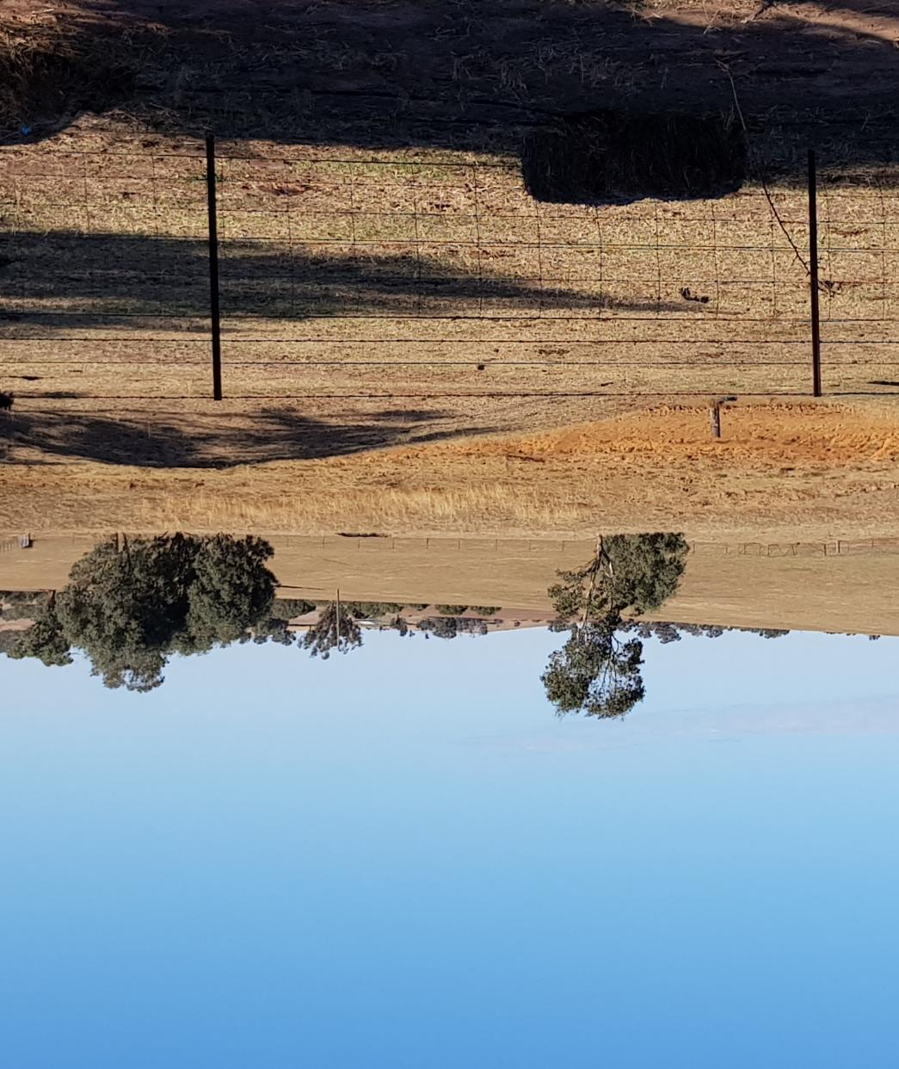
Quote from farm 1
“I remember getting really annoyed with my father once. I was felling a tree and just as it was falling I noticed he was standing right where it was coming down. I yelled at him to get out of the way and luckily it missed him. We had a thing or two to say to each other. He didn’t have his eyes open.”
Farm 1 ‘Retiring entrepreneur’

Slide 37
4.1
Farmers learn first from their parents and primarily learn through trying and doing, with little consideration of risk
“
They [their children] have grown up sitting up there beside you so they are probably safer than other people who are meant to know what they are doing.
– Farm 8 ‘Returned to farming’
Farmers, especially the older generations, and those who have worked on the same property for their entire work life, have acquired most of their on-farm knowledge and skills directly from the previous generation rather than other external sources of training and education. Other skills are gained on the job and often through trial-and-error.
“
I have a forklift licence, that helped me operate a tractor, most of the equipment is pretty similar.
– Farm 9 ‘My farm is a workplace’
Key insights
“
Farmers often acquired new equipment without prior understanding of, or training in, how to operate it.
The generational transfer often results in the incorrect or unsafe operation of equipment being passed from generation to generation and from owner to employee.
Understanding the consequences of hazards is important in adjusting behaviour.
The newer generation of farmers are receiving external training and qualifications, yet still place the highest value on experiential knowledge.
The new generation are critically evaluating previous ways of doing things and seeking out information or advice on how to operate equipment correctly.
We bought a bandsaw because we needed one for the workshop. None of us had ever used one so I just looked through the manual and gave it a go and then a taught the rest of the guys how to use it.
– Farm 4 ‘Father and son family farm’

Slide 38
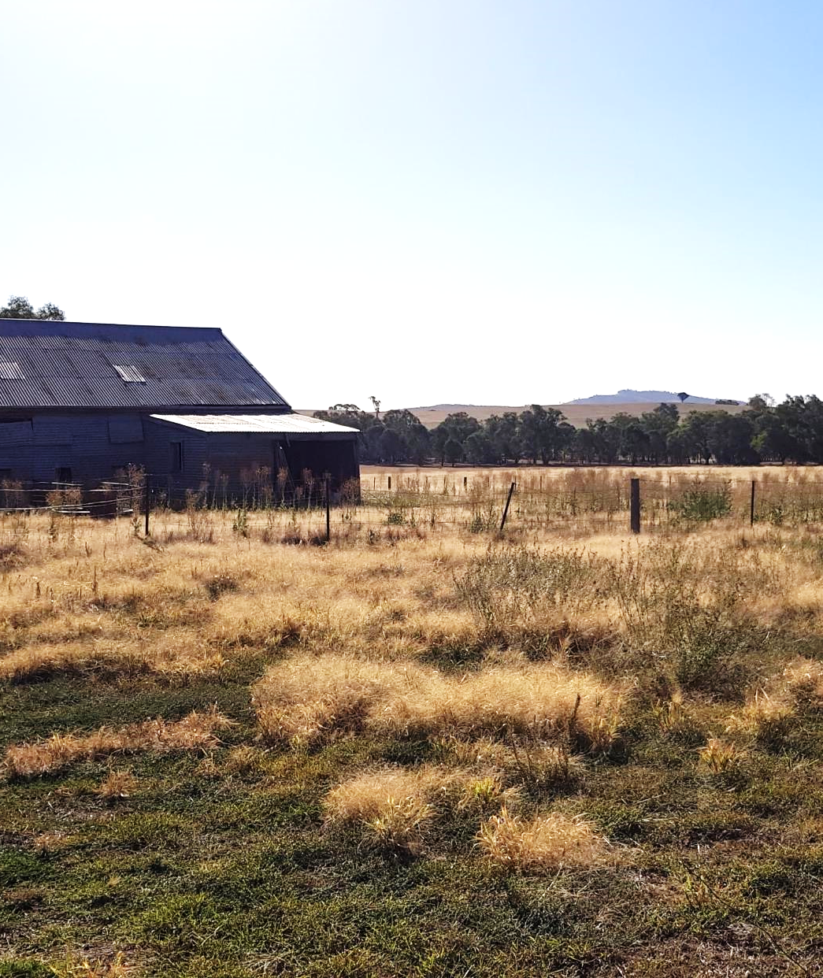
Quote from farm 6
“The shearing shed is probably fifty years old, it’s got some problems but it still works, its pretty basic and I think there is asbestos in the roof. These days you can get shearing sheds with raised floors so the shearer doesn’t have to bend as far, front fill pens to make it easier to get the sheep in. That would all be great but I can’t afford to make that investment right now.”
Farm 6 ‘There’s more to life than farming’

Slide 39
4.2
Hazards and risks are inherited with the generational transfer of a farm business
“
[When asked about ventilation in the shearing shed] there’s no ventilation and in winter it gets freezing in here so we close it all up to stop us from freezing.
– Farm 6 ‘There’s more to life than farming’
On-farm processes and systems e.g. the use of and storage chemicals, are often inherited from the previous generation as equipment and infrastructure is often also transferred at time of inheritance. This transfer can result in poor practices being continued by the next generation or legacy farm layout contributing to higher risk of an incident.
.
“
Some of the infrastructure on the property is 60-70 years old...They don’t fit new equipment.
– Farm 8 ‘Returned to farming’
Key insights
Farmers who had not inherited their farm business were provided with a distinct opportunity to critically assess the hazards and consider best practice ways of operating when designing on-farm systems and processes and using existing infrastructure.
Economic pressures and the financial position of farms can make it difficult for farms to replace systems, equipment and infrastructure, or change processes.

Slide 40
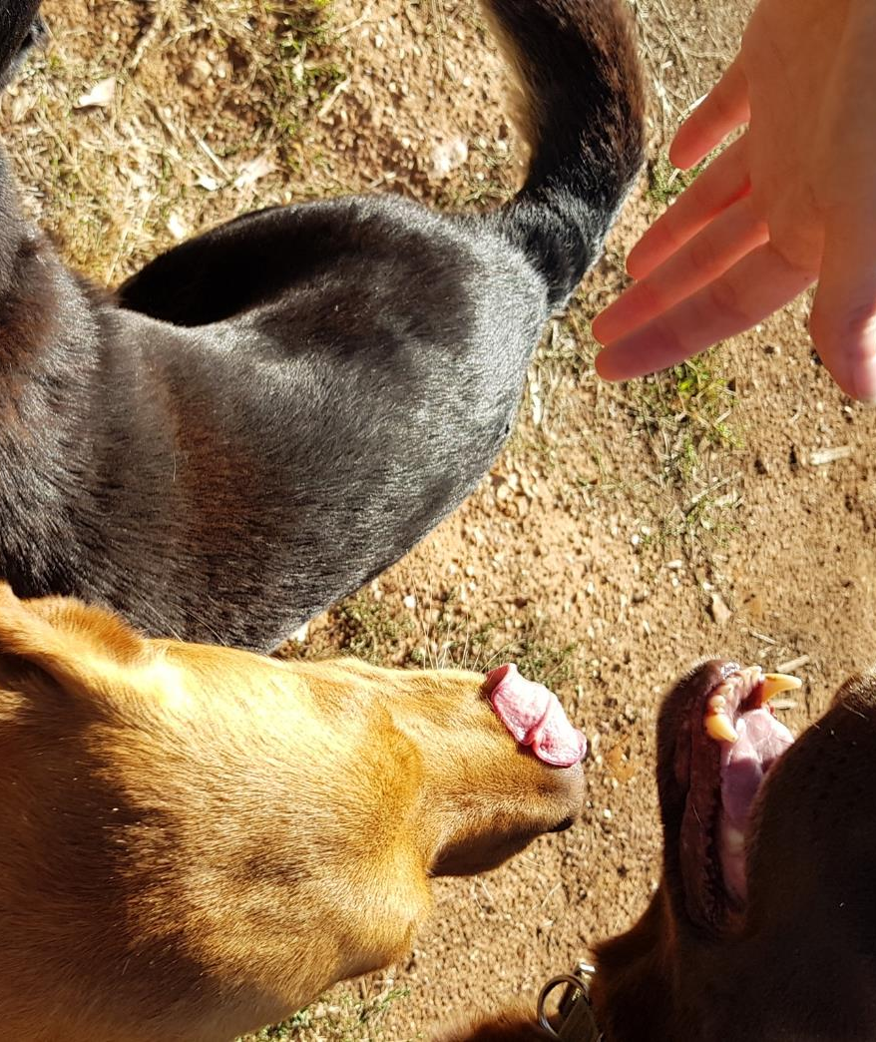
Quote from farm 4
“Life is busy now. We’re trying to get him to slow down. He has no work-life balance. He’s a workaholic. He lives and breathes it. We try and plan holidays and get him off the farm, but it’s hard.”
Farm 4 ‘Father and son family farm’

Slide 41
4.3
Family farms do not have a clear line between home and workplace
“
I probably shouldn’t tell you this, but I have been driving the ute since I was 7 years old.
– Farm 4 ‘Father and son family farm’
The cliché of “farming is in their blood” is an idea that many farmers, especially older farmers, identify with. The strength of this identity and the associated connection to land appears to stop farmers from distinguishing between their responsibilities and duties to others when working on their farm, versus when in their home.
“
You see some bad set-ups, but you can’t say anything, it’s his farm
– Farm 7 ‘Set in his ways’
Key insights
“
I’m glad we didn’t go to WorkCover, they would have said my husband had to take a break … if that happened the farm work would’ve stopped, we might’ve lost it
– Farm 5 ‘Drought affected’
This lack of clear delineation between work and home and personal identity and occupation appears to result in behaviours which may be appropriate or acceptable outside of a workplace being applied while working on the property.
Farmers often see things that may be optional on a private property as also optional on the farm businesses property.
Farmers that have had a point of separation from the farm e.g. external study, off-farm employment, appear to be more aware of the need to distinguish between the farm as a business and as their home and their identity and their occupation resulting in a higher regard for workplace health and safety etc.
Safety messages may risk becoming personal, as they risk speaking to how the farmer should behave in their own home.

Slide 42
Opportunity areas
04

Slide 43
Opportunities identified through our research
Challenge | Opportunity
Work practices and ethics are passed from generation to generation, including bad practice | What if we target the next generation to make them and their parents more aware of safety? How might we expose farmers to best practice and demonstrate different, safer ways of working?
Safety is not prioritised when making investment decisions | How might we show the value of safety and their own health in the context of long term farm productivity? How might we show the impacts of unsafe practices in economic terms? What if we could quantify the economic value of safe practices? What are the opportunities to retrofit safety improvements on old or cheaper equipment and how do we improve take-up of these options?
It is difficult to change a working farm to be safe by design while it is in operation | What if we provided practical, incremental safety adjustment tips to common farm infrastructure?
Farmers do not see their duty of care extending to contractors and many others on the farm | What if we made it clear who holds workplace health and safety duties? How might we encourage conversations about safe work between contractors and farm managers?
Seasonal workers and labour hire draw from populations that have not grown up on farms and may have English as a Second Language, creating risk | How might we improve our understanding of contractors and labour hire? How can farmers be supported to feel confident about sharing information to help manage their duties toward seasonal workers? How might seasonal and labour hire workers be supported to understand their WHS duties and the WHS context in Australia?
Safety knowledge is acquired through trial and error rather than pro-actively and preventatively | What if we extend certification and refresher programs in more areas of farm practice? How might we provide more opportunities for safety training in formal and informal settings, as part of existing farm life and business interactions?
Farmers draw knowledge from their community, making it hard to influence from the outside | What if we leveraged the goodwill of farmers to lead community safety initiatives? What if safety interventions and campaigns were community driven, co-designed and locally delivered? How might we ethically draw on local farming stories to improve safety?
Data into family farm incidents is limited and likely under-reported | How might we get data that shows who and how incidents happen, to better plan and measure interventions? What if communities surfaced their own issues and reported priority areas important to them? What if we supplemented incomplete data sets with qualitative intelligence gathering?
Fatigue and long hours of the primary farmer is seen as part of the job | How might we increase a farm manager’s willingness to bring in help for peak working periods? How might we encourage farmers to consider healthy work-life balance and feel able to take holidays?

