Slide 1
This presentation is intended for use by trainers with a working knowledge of the GHS and older labelling and classification systems in Australia

Slide 2


The Globally Harmonised System of Classification and Labelling of Chemicals
This presentation is released under the Creative Commons
Attribution 3.0 Australia Licence and may be reused and redistributed free of charge.
For more information see www.swa.gov.au/sites/swa/copyright

Slide 3
Welcome and overview
Part 1: An Introduction to the GHS (45 minutes)
Classification and hazard communication - “old” systems in use in Australia
The GHS – what it is, why it was developed, what it aims to do, what are its benefits.
The GHS and the WHS Regulations – Scope and Application
  How does the GHS work
  GHS Hazard Class and Categories
Hazard communication
  Labelling and Safety Data Sheets
    Signal words, pictograms, hazard statements, precautionary statements
  Example labelling and SDS
Questions.
Morning tea (20 minutes)

Slide 4
Part 2: Classifying chemicals according to the GHS (1 hour)
What is classification?
Where do I get information to help me classify
Cut-off limits
Practical Example classifications
  Single chemical
  Mixtures
Questions (feel free to ask at any time).

Slide 5
Part 1:
An Introduction to the Globally Harmonised System of Classification and Labelling of Chemicals

Slide 6
Classification and hazard communication
Prior to Work Health and Safety (WHS) Regulations, classification/hazard communication for workplace chemicals done to:
  Classification
    Approved Criteria for Classifying Hazardous Substances
    ADG Code, 7th Edition
    List of Designated Hazardous Substances
  Labelling
    National Code of Practice for the Labelling of Workplace Substances
    ADG Code, 7th Edition
  (Material) Safety Data Sheets
    National Code of Practice for the Preparation of Material Safety Data Sheets
The WHS Regulations introduce a new system of classifying chemicals.
  The Globally Harmonised System of Classification and Labelling of Chemicals
Notes:
Harmonised work health and safety (WHS) legislation for hazardous chemicals was introduced in several states and territories on 1 January 2012 and 1 January 2013.
Under the previous frameworks, manufacturers, importers and suppliers had duties to classify, label and produce safety data sheets for workplace hazardous chemicals. That duty remains unchanged under the WHS legislation. If you had that duty before, you will continue to have it.
However, there are some changes involved by incorporating the GHS into the new WHS framework.
End-users of chemicals will also need to understand what the GHS means for them; what do the new pictograms mean? What do the new hazard categories mean? What information is available, where to find it and how to use it?

Slide 7
What is the GHS?
The GHS of Classifying and Labelling of Chemicals:
  Comprehensive tool that harmonises chemical classification and hazard communication.
Harmonised criteria for classification – physical, health and environmental
  Applies criteria to classify chemicals based on intrinsic hazards
  Covers single substances, solutions and mixtures.
Communicates hazard information of hazardous chemicals on labelling and safety data sheets.
  Hazard classes
  Symbols, signal words and hazard and precautionary phrases
  Standardised Safety Data Sheet format.
Some changes to systems are required and will be obvious to end users.
  Training for staff to understand GHS
Notes:
The GHS has been developed by the United Nations as a non-binding treaty for UN member countries.
It was developed as a non-binding framework which countries could adopt into their regulations by legislation.
It is continually reviewed and updated by a UN Sub-Committee.
It was developed as a framework which could be adopted into countries’ chemicals regulations by legislation.

Slide 8
Why was the GHS developed?
Many different systems existed worldwide, with differing requirements:
  Vary in hazards covered and classification criteria used
  Information required on labels and SDS varied
  Result = disparity in the information provided.
Hazards are an intrinsic property of a chemical. Classification should be consistent!
Often leads to conflicting and inconsistent classifications and safety information:
  Chemicals are often classified differently (even in the same country).
  Labelling and SDS requirements vary from country to country.
Some countries have little or no requirements in force.
  Often levels of literacy are low
  Desire to improved the safety outcomes in these countries?

Slide 9

















Why was the GHS developed?
Hazard symbols / pictograms
What do all these symbols mean?
?
WHMIS (Canada)
European Union
ADG Code
The ADG Code has no symbol for chronic/severe health effects.
The GHS standardises these symbols on labels/SDS
Notes:
While most of these symbols may be well-known, others may not be necessarily clear to the end-user of a chemical. Training of staff is key to ensure these symbols are understood.
The ADG Code has no symbol for chronic health hazards, sensitisers and other, non-acute health effects.
The GHS standardises hazard symbols and pictograms on labelling of hazardous chemicals.
In WHMIS “R-symbol” means “dangerously reactive materials” – for example, explosives.
“Exclamation T” means “materials causing other toxic effects (not acute or immediate)” – for example, carcinogenic.

Slide 10
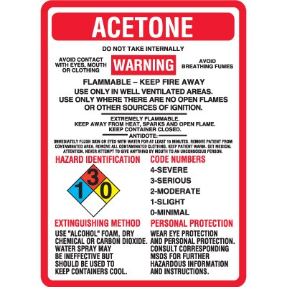
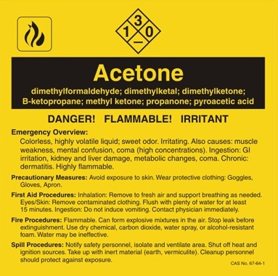
Why was the GHS developed?
Labelling inconsistencies
Notes:
Labelling is often the only information about a chemical that an end-user will see.
Note the different signal words for acetone – Danger vs. Warning.
One label says acetone is irritant and causes dermatitis, the other makes no mention of irritation effects.
One label contains information about safe use, the other refers user to SDS.
One label contains a “flame” symbol, the other has no pictorial representation of hazard.
There is even contradicting information on same label – Flammable and Extremely Flammable.
Again, the GHS standardises the information required on labelling.

Slide 11
How was the GHS developed?
The GHS is based on considered best practices of chemical hazard communication.
  USA and Canada for workplace, consumers and pesticides
  EU directives for classification and labelling of substances and preparations
  UN Recommendations on the Transport of Dangerous Goods
Because the basis already existed, countries’ systems would be maintained or improved by adopting the GHS.
  In Australia
    ADG Code (based on UNRTDG)
    Approved criteria (based on EU directives)
Notes:
Many aspects of the GHS are already in place in Australia in various legal instruments. This means you need to get used to new terminology introduced by the GHS and what it all means for you.

Slide 12
The GHS – Fundamental approach
The GHS would be based on the classification of intrinsic properties of chemicals on a hazard-based approach and would include:
    Physical hazards
    Health hazards
    Environmental hazards
One chemical, one classification.
If validated data exists for a chemical, then it should be useable for classification.
The GHS needed to be comprehensible
  Need to make it easily understandable for everyone
  Minimal training required
Notes:
The GHS provides a hazard-based system of classification, rather than a risk-based approach.
It lets users of chemicals know the intrinsic hazards involved in handling a chemical and how to manage potential risk of exposure.
It does not take the approach that if you follow the label, then we do not tell you the hazards as the hazard usually remains.

Slide 13
What are the potential benefits of the GHS?
The GHS provides many benefits to governments, industry and chemical users:
  Reduces need for duplicative testing and evaluation of chemicals.
    Principles of animal welfare
  Single approach to labels and safety data sheets.
  Classification criteria are updated and maintained at an international level.
    Increased efficiencies and reduced costs of compliance.
    Easier trade of chemicals; no need to reclassify in every jurisdiction.
    An increased understanding among the wider community of chemical hazards.
  Enhanced safety outcomes for protection of human health and environment through harmonised chemical safety and health information.
Notes:
If a chemical or mixture has been tested elsewhere, you can use that information to classify.
It follows one classification is required to meet the requirements in all countries that have implemented the GHS.
The UN is responsible for updating the GHS.
No need to relabel or produce different labels for countries into which you are selling.
Labels and safety data sheets contain standardised information and do not need to produce various forms to meet requirements of other jurisdictions.
Standard safety information means everyone understands symbols and words to mean the same thing.

Slide 14
Implementation and Development of the GHS
Who is responsible for implementing and updating the GHS?
The GHS is a non-mandatory, international legal instrument
  Countries adopt the GHS into their legal frameworks
Overseeing national implementation is the responsibility of the “competent authority”
  For workplace health and safety - Safe Work Australia
  Can be implemented by many sectors in each country
    E.g. Consumer, Agrochemical, Transport, Environment and others
The GHS is maintained internationally by a UN Sub-committee of Experts.
  More than 30 countries are on this committee
    Australia is represented by Safe Work Australia
  Observer countries and other stakeholders also participate
Notes:
Although Safe Work Australia is responsible for overseeing the implementation of the GHS, it is not a regulator and does not oversee compliance. Enforcement and compliance remains the responsibility of state and territory governments.
The GHS has been implemented into the WHS framework. No other sector has implemented it yet. The transport sector, through the ADG code, recognises GHS labelling as satisfying inner-packaging requirements.
Agvet chemicals which are workplace chemicals must also comply with the requirements of WHS. More on that later.
Other sectors in Australia are considering the implications of the GHS for their legal frameworks.

Slide 15
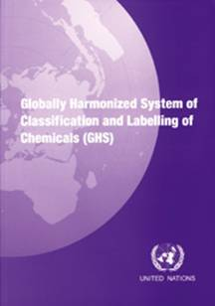
Who has implemented the GHS?
New Zealand was the first country to implement the GHS as part of HSNO.
Australia implementing 3rd Revision of the GHS as part of WHS Harmonisation
Other jurisdictions Include:
  Japan, China, Singapore, S. Korea (and other ASEAN)
  EU adopted as part of REACH (finalised by 2015)
  USA adopted in 2012 (finalised at same time as EU)
  Canada, Brazil and many others currently preparing.
The GHS is updated and revised every two years:
  Future versions of the GHS will be taken up during reviews of the WHS legislation
  Available free from UN’s website
Notes:
In 2003, the UN adopted the GHS – NZ implemented a draft version as part of its HSNO Regulations.
The 4th revision was published in 2011 and the 5th revision in 2013.
The GHS text can be downloaded for free from the UN’s website at: http://www.unece.org/trans/danger/publi/ghs/ghs_rev03/03files_e.html
Hardcopy and CD-ROM versions are also available for purchase through the UN.

Slide 16
The GHS and the WHS Regulations
Scope and Application
The GHS now in jurisdictions who have implemented the WHS Regulations.
  Transition period applies - 31 December 2016
  By then, all workplace hazardous chemicals must be classified and labelled according to the GHS.
  Until that time, classification can be done according to the older framework.
All hazardous chemicals in the workplace are covered:
  Substances, products, mixtures, preparations, formulations, etc.
  GHS hazard classes and categories closely reflect existing coverage in Australia.
The GHS does not replace the ADG Code.
Notes:
A 5 year transition period was chosen to coincide with the requirement to review safety data sheets at least once in every five years. However, manufacturers and importers are free to classify according to Approved Criteria / ADG Code until the end of the transition period.
However, it is recommended that the move to GHS is made as soon as practicable (e.g. when SDS of a chemical is due for review).
Does not cover cosmetics, consumer chemicals, Agvet chemicals at the point of intentional administration.
However, it does cover workers who may be exposed in the workplace and during transport.
The GHS does not replace the ADG Code. Whatever you are currently doing to meet transport requirements, continue to do it. These duties will continue to remain.

Slide 17
The GHS and the WHS Regulations
Scope and Application
Hazardous chemicals must be correctly classified by the manufacturer / importer.
Hazardous chemical is a “new” term introduced by the WHS legislation.
  Previously, classification existed under two systems, both with environmental criteria.
These definitions have been “merged” under the term “hazardous chemicals”.
Hazardous chemicals
Hazardous substances
Dangerous Goods
Physical / Health
Physical / Health
Env.
Physical / Health
Env./Bio./Radio.
Bio./Radio.
Env.
Approved Criteria
WHS Regulations
ADG Code
Environmental hazards are not mandated for classification.
  Best practice is to include environment hazards where known.
Notes:
Hazardous substances are those which meet the criteria of the NOHSC Approved Criteria (2004).
Dangerous goods are those which meet the criteria of the ADG Code, 7th Edition.
A hazardous chemical is effectively an amalgamation of these two definitions, except environmental hazards are not mandated by the WHS legislation.
Effectively, a hazardous chemical is a chemical that has the potential to harm human health through workplace exposure or to cause damage to people or property.
Biohazards and radioactive materials are not covered by the chemicals part of the regulations, however, general duties would still apply to these materials.

Slide 18
The GHS – Scope and Application
How does it work?
A chemical is classified against the criteria of each hazard class and category under:
  Physical hazards
  Health hazards
  Environmental hazards (not mandatory)
If it meets the criteria of the GHS in one or more class, it is a hazardous chemical.
  Some hazard classes are excluded by the WHS Regulations.
  Hazardous chemicals include a single substance, mixture or article.
Each hazard class is split into:
  Divisions (explosives only)
  Categories
  Types (applies to organic peroxides and self-reacting substances).
Notes:
Physical hazards include, for example, flammable liquids and gases, oxidisers and explosives.
Health hazards include, for example, acute toxicity and carcinogenicity
Environmental hazards are those compounds which are toxic to aquatic life and damaging to the ozone layer.

Slide 19
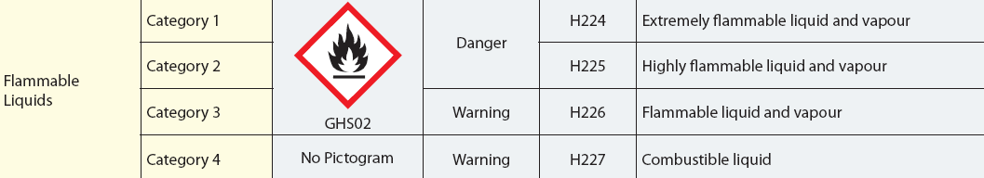
The GHS – Scope and Application
How does it work?
Hazards information is prescribed to end users:
  Symbols (pictograms)
  Signal words
  Hazard statements, and
  Precautionary statements.
These elements are then put onto:
  Labels
  Safety data sheets
Notes:
The manufacturer or importer has the duty to correctly classify a chemical and ensure the label and safety data sheet are produced.
Most changes that end users see will be on labels and safety data sheets.
It is important to understand what the new information (symbols and words) means.

Slide 20
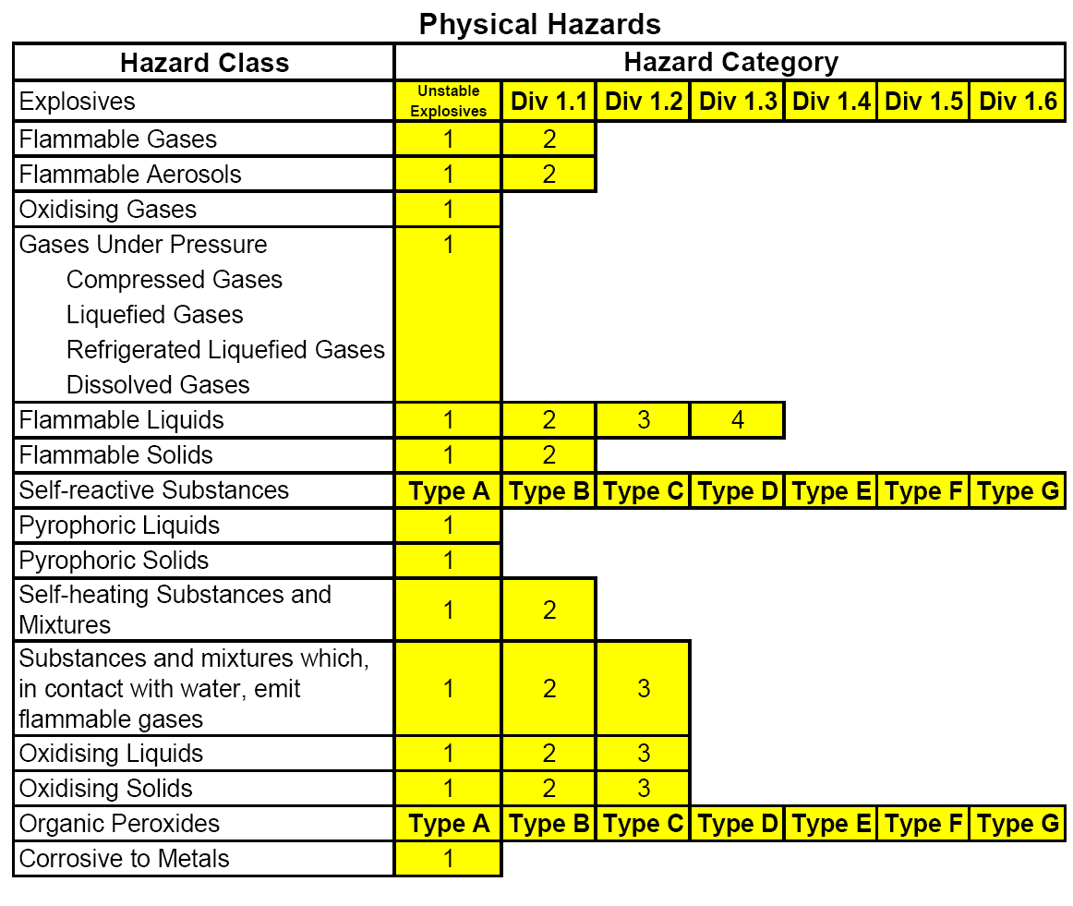
The GHS – Hazard Classes and Categories
Notes:
The WHS Regulation do not mandate the classification of Flammable Gases: Category 2 (which aligns the requirements with the ADG Code).
These are the “building blocks” of the GHS. Jurisdictions are free to choose building blocks to best suit or match their current requirements. Hence there may be varying requirements for the GHS between countries and between sectors within countries. However, the criteria for each class and category are harmonised and cannot be changed.

Slide 21
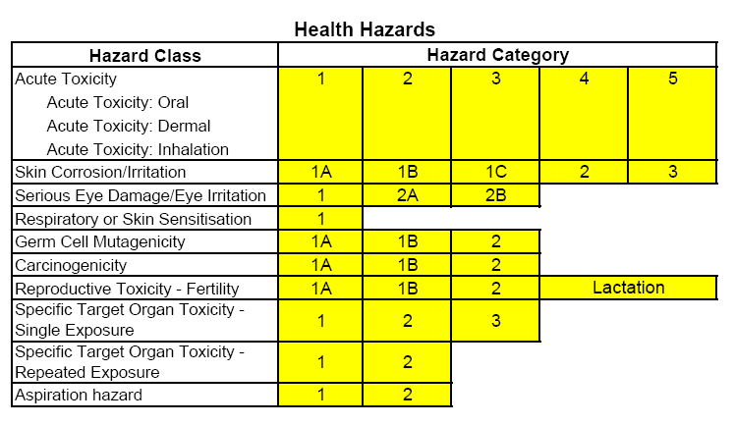
The GHS – Hazard Classes and Categories

Slide 22
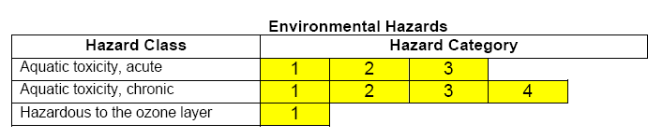
The GHS – Hazard Classes and Categories
Not compulsory under WHS Regulations.
Environmental classification may still be required for transportation.
Notes:
Although it is not mandatory, it is considered best practice to classify workplace chemicals according to environment classifications. This is often required for transport purposes anyway. Suppliers and manufacturers, where environmental classifications are known, are encouraged to put this information on to workplace labelling and safety data sheets to inform workers of the intrinsic hazard.

Slide 23
Non-GHS Hazard Statements
The are several additional classifications which are not in the GHS.
Mandated through Codes of Practice.
AUH001 – Explosive when dry
AUH006 – Explosive with or without contact with air
AUH014 – Reacts violently with water
AUH018 – In use may form flammable/explosive vapour/air mixture
AUH029 – Contact with water liberates toxic gas
AUH031 – Contact with acid liberates toxic gas
AUH032 – Contact with acid liberates very toxic gas
AUH044 – Risk of explosion if heated under confinement
AUH066 – Repeated exposure may cause skin dryness and cracking
AUH070 – Toxic by eye contact
AUH071 – Corrosive to the respiratory tract
Notes:
These classifications do not, on their own, result in pictograms appearing on the label, but manufacturers and importers should put this information on the label and the safety data sheet when it is required.
The criteria for classification under these categories is given in the labelling and SDS Codes of Practice and the classification guidance.
These additional classes also exist in EU legislation.
It is highly unlikely that a chemical will belong to one of these categories alone and not be classified as hazardous under another category.

Slide 24


Hazard communication – Labels
A label is the written, printed, or graphical information that is affixed to, printed on or attached to the container of a hazardous chemical.
Harmonised elements under the GHS
  Signal words
  Indicate the relative severity of the intrinsic hazards
  Pictograms
  Symbols signifying hazards of chemical, e.g.
  Hazard statements
  Phrase describing the nature of the hazards a chemical possesses
  Precautionary statements
  A phrase describing measures to be taken to minimise adverse effects of exposure to, or improper handling of, a hazardous chemical (Prevention, Response, Storage, Disposal).
Notes:
Requirements of SUSMP will still be acceptable and meets the requirements of the WHS Regulations for labelling - no requirement to put GHS information on such chemicals. However, if the manufacturer or importer determines that the use handling and storage of the chemicals are predominantly related to a work activity, the label must meet WHS requirements.
For chemicals regulated by the APVMA, these must comply with most requirements of GHS labelling under WHS Regulations. Signal words and pictograms do not need to appear. Hazard statements and precautionary statements must apply to warn of residual hazard (SDS requirements MUST be met – which must be to full requirements of WHS, with full suite of label elements on the SDS).

Slide 25
The GHS – Signal words
Signal words are prominently displayed words on labelling to:
  Alert the label reader to a potential hazard, and
  Indicate the relative severity of the hazard
There are two signal words used on label in the GHS. These are:
  DANGER
  WARNING
DANGER indicates a higher severity of hazard compared to WARNING
  Under the previous systems, signal words included:
    Danger, Warning, Hazardous, Poison, Dangerous Poison
Notes:
If other types of signal word are required under other legislation, then it will be shown on the label.

Slide 26
The GHS – Pictograms
The GHS prescribes 9 pictograms to convey the hazards of chemicals
Two new symbols are introduced
All relevant pictograms will appear on label (according to the prioritisation rules).
  In practice more than 4 pictograms is very rare
Notes:
The pictograms are the same shape as the Dangerous Goods labels (a square set at a point) and most, except the exclamation mark and the “health hazard symbol”, will be familiar. These are new symbols under the GHS to help convey health hazards that were not covered by the Dangerous Goods Code.
The border is red on a white background. If the product is for the domestic market only and is not for export, then the border can be black.
Each pictogram has an official name. The “health hazard” pictogram is colloquially known as “Star Man”, “Exploding torso” and others.
Priority rules: Rules for prioritising pictograms to preserve space on label and to prevent possible contradiction of information.
If skull and crossbones appears, exclamation mark will not appear.
If corrosive appears, exclamation mark will not appear for skin or eye irritation.
If health hazard appears for respiratory sensitisation, exclamation mark will not appear for skin sensitisation or skin or eye irritation.
If a transport pictogram appears, the equivalent GHS pictogram will not appear.

Slide 27










The GHS – Pictograms
The GHS also allows dangerous goods class labels to be displayed on labelling and safety data sheets.
There are no equivalents to the “exclamation mark” and “health hazard” pictograms.
1
2
3
4
5
6
8
9
Dangerous Goods Class
Notes:
Manufacturers and importer can continue to use the dangerous goods diamonds on labels if they wish.
Of course, depending on transport requirements it may be mandatory to have the dangerous goods pictogram on the container.
Note there is no dangerous goods equivalent of the exclamation mark and the health hazards symbols.
Note that DG class 7 (radioactive) is not covered by GHS. Neither is 6.2 (infectious substances).

Slide 28

Possible issue with flammable chemicals?
Did anyone spot a possible issue with flammable symbols?
6 different “flammable” symbols become one – intrinsic hazard not always obvious at a glance.
  Read label e.g. In contact with water releases flammable gas
  NO CHANGE TO PLACARDS - DG symbol still required
Notes:
Although the workplace label may change, the placard symbol will not. Therefore, in emergency situations, fire crews and response personnel will still have the information to deal with the situation.
Manufacturers can choose to put the dangerous goods symbol on labelling.

Slide 29
Placarding
FLAMMAZENE
UN No.
9999
HAZCHEM
4YE
Notes:
By keeping DG symbols on placard, emergency services can see more quickly the hazards.

Slide 30
The GHS – Hazard statements
Describe the nature of the hazards covered by the GHS and the degree of severity.
  Examples include:
    Extremely flammable liquid and vapour (Cat. 1)
      Highly flammable liquid and vapour (Cat. 2)
        Flammable liquid and vapour (Cat. 3)
          Combustible liquid (Cat. 4)
    May cause cancer (Cat. 1)
      Suspected of causing cancer (Cat. 2)
Hazard statements are equivalent to Risk Phrases under the Approved Criteria.
    Extremely flammable (R12)
      Highly flammable (R11)
        Flammable (R10)
    May cause cancer (R45)
      Limited evidence of a carcinogenic effect (R40)
Notes:
Most R-phrases under approved criteria will have an equivalent in the GHS.
This means conversion between the two systems is straightforward in most cases.
Note that the GHS hazard statements can be more descriptive – e.g. warning of hazardous vapours.

Slide 31
The GHS – Precautionary statements
Describe measures recommended to prevent or minimise:
  The adverse effects of exposure to a hazardous chemical, or
  Improper handling of a hazardous chemical.
Each hazard class / category has several associated precautionary phrases.
  Prevention, Response, Storage, Disposal.
For example, for a flammable liquid, the following statements may apply:
  Keep away from sparks and open flames. No smoking. (Prevention)
  In case of fire: Use powder for extinction (Response)
  Store in a well-ventilated place. Keep cool. (Storage)
  Dispose of contents/container in accordance with local regulations. (Disposal)
Notes:
In general, 6 to 10 precautionary statements will appear on a label and safety data sheet.

Slide 32
The GHS – Other information on labels
Product identifier (and ingredient proportions)
Supplier / manufacturer details
Supplementary information , where applicable, such as:
  hazard classes and hazard statements not specifically covered by the GHS
  expiry or retest date.
  UN number

Slide 33
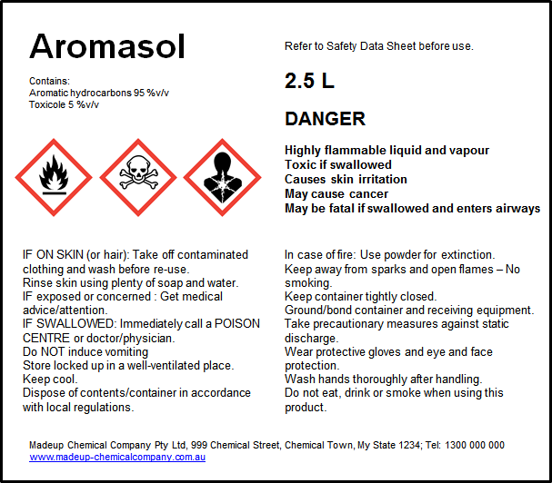
Examples of GHS labels
Product identifier
Ingredient proportions
Signal word
Hazard pictograms
Hazard statements
EXAMPLE
Precautionary statements
Supplier information
Notes:
Labels showing all these GHS elements are likely to appear on medium to large-sized containers, where there is enough space to display all the relevant information.
There is no standardised format for labels. Manufacturers can produce labels as they wish, as long as the required elements are present.

Slide 34
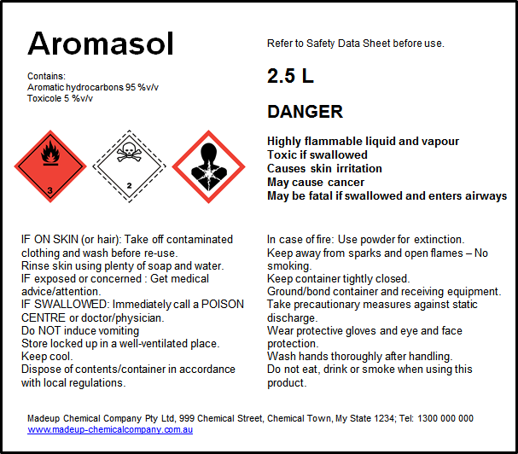
Examples of GHS labels
Label suitable for transport
DG Class Labels
EXAMPLE
Notes:
This label meets the transport and workplace hazardous chemical labelling requirements.
The equivalent GHS pictograms are not acceptable for transport purposes.
There are several arrangements of labels possible.

Slide 35
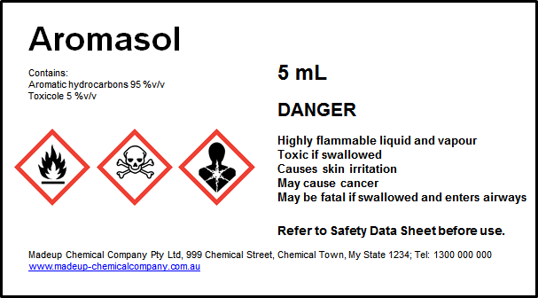
Examples of GHS labels
Label for small container
EXAMPLE
Refer to SDS
When the label does not have enough space, some label elements can be omitted.
The Safety Data Sheet contains more detailed information
Notes:
There are no precautionary statements on this label.
Where, for reasons of space and clarity, the supplier has not put all GHS labelling elements on the label, more detailed information, such as precautionary statements, can be found on the Safety Data Sheet.

Slide 36
The GHS – Safety Data Sheets
The GHS also provides a minimum standard for the formatting and content for communicating a chemical’s hazard through Safety Data Sheets (SDS).
A Safety Data Sheet is a document that provides detailed information about a hazardous chemical, including:
  Its identity and its ingredients
  Its physical, health and environmental hazards
  Workplace exposure standards
  Safe handling and storage procedures
  First aid procedures
  Transport information
  and other useful information.
Sections of the SDS are aimed at a particular audience.

Slide 37
The GHS – Safety Data Sheets
There are very few changes to SDS by moving to the GHS.
The majority of changes to Australian SDS will relate to sections where GHS information is required.
For example:
  Section 2 contains classification information
    Including pictograms, hazard statements, etc.
  Section 3 contains information on ingredients in mixtures.
Most other sections and information contained in the SDS remain unchanged.
Notes:
Changes needed where information from the GHS is required. Nearly everything else is identical. The most minor of changes is the name – Material Safety Data Sheets now called Safety Data Sheets.

Slide 38
The GHS – Safety Data Sheets
The information in an SDS is provided in 16 sections.
These sections are the same as the current requirements and in the same order.
Identification
Hazard(s) identification
Composition and ingredient information
First aid measures
Fire-fighting measures
Accidental release measure
Handling and storage
Exposure controls and PPE
Physical and chemical properties
Stability and reactivity
Toxicological information
Ecological information
Disposal considerations
Transport information
Regulatory information
Any other relevant information
Notes:
The format of the SDS remains (almost) unchanged – Australia was responsible for development of the SDS format at the GHS level.

Slide 39

The GHS – Safety Data Sheets
SECTION 2: HAZARD(S) IDENTIFICATION
Classification of the substance or mixture
Flammable liquids (Category 2); Acute toxicity – Oral (Category 3)
Skin irritation (Category 2); Carcinogenicity (Category 1A)
Aspiration toxicity (Category 1)
Label elements
Pictograms:
Signal word: DANGER
Hazard statement(s):
H225 Highly flammable liquid and vapour
H301 Toxic if swallowed
H315 Causes skin irritation
H350 May cause cancer
H304 May be fatal if swallowed and enter airways
Precautionary statements:
P210 Keep away from sparks and open flames. No smoking
P233 Keep container tightly closed
EXAMPLE
Flame
Skull and crossbones
Health hazard
Notes:
The major change to the information presented on an SDS will be in section 2, where the chemical’s classification(s) and labelling elements should be presented. The information in the rest of the SDS will remain largely unchanged.

Slide 40
Further reading on GHS under WHS Regulations
Codes of practice
  Labelling of Workplace Hazardous Chemicals
  Preparation of Safety Data Sheets for Hazardous Chemicals
  Managing the Risks of Hazardous Chemicals in the Workplace
Guidance material
  Classification of Hazardous Chemicals under the WHS Regulations
Fact sheets
  Classifications and Labelling for Workplace Hazardous Chemicals (poster)
  Understanding Safety Data Sheets for Hazardous Chemicals
  Understanding Hazardous Chemical Labels
See: www.swa.gov.au for these publications and more

Slide 41
Thank you for your attention
Any questions?
Web: www.swa.gov.au
Email: info@swa.gov.au
Phone: 1300 551 832

