Slide 1
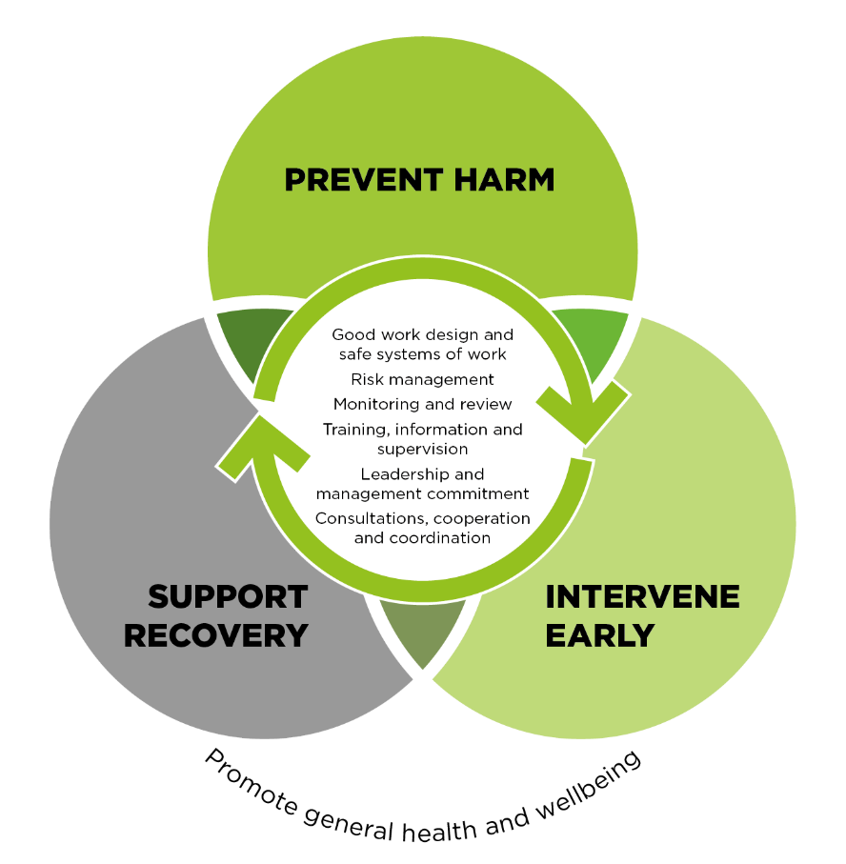
Mental Health Strategy 2022-2024
OUR COMMITMENT
OUR OBJECTIVE
We are committed to ensuring the health and safety of our workers and providing a mentally healthy workplace. A mentally healthy workplace is one that promotes and supports a culture of positive mental health & wellbeing and practices.
We want to ensure the work we do does not put the mental (psychological) health of our workers at risk. This means proactively identifying and eliminating or minimising, any psychosocial risks in our workplace.
OUR MENTAL HEALTH MODEL
PREVENT HARM
INTERVENE EARLY
We will focus on work health safety and wellbeing practices to prevent harm to our employees by identifying and assessing work-related risks and hazards, implementing effective prevention and control measures, and consulting effectively with employees to improve their understanding and confidence around mental health issues. Key actions we will take to prevent harm include:
Fostering appropriate behaviour and managing harmful behaviour effectively by:
Implementing the Respect in the Workplace Policy which provides a clear, safe and trustworthy process for employees to raise concerns and report harmful behaviour.
Making our Agency a place where employees engage in respectful and dignified workplace interactions, which support positive workplace mental health and wellbeing.
Identifying hazards and managing risks by:
Understanding job roles that are exposed to potential hazards and better designing these roles to eliminate psychosocial hazards and improve psychological health.
Creating a workplace culture where speaking up about possible hazards is encouraged and supported without judgment, criticism and recrimination.
Promoting and celebrating a positive workplace environment by:
Committing to supporting managers and developing their capability.
Embedding effective organisational change practices and consulting and engaging with employees in relation to these.
Allowing employees to express feedback, ideas or raise concerns in a safe and supported environment.
Committing to proactive, open and honest communication throughout the Agency.
Removing the stigma and myths surrounding mental health and championing the importance of taking steps to improving individual mental wellbeing.
Providing supportive, flexible and adaptive working arrangements for employees based on the needs of the individual and with consideration to the operational needs of the organisation.
We will ensure a best-practice approach to early intervention is understood and applied through the Employee Assistance Program (EAP) and other preventative measures in our workplace. This includes:
recognising the signs of changed behaviours (increased absenteeism, mood swings, lack of motivation, decline in performance etc.) and modifying work to suit the employees’ circumstances.
providing ongoing communication with employees who are away from work due to injury or illness and ensure they have positive return to work experiences.
SUPPORT RECOVERY
CULTURE
We will provide timely and sustainable support of employees’ recovery by:
Remaining up to date with developments and improvements in the management of mental health and mental health recovery in the workplace.
Building resilience of employees to fulfil their potential at work or return to work.
This Mental Health Model is based on our national guidance material and aims to empower managers and employees to work together to build safe, inclusive workplace cultures and effective systems for preventing harm and promoting good mental health.
More information on the Model and the Mental Health Strategy can be found on the intranet. You can also contact People Strategies at any time.
PROMOTE GENERAL HEALTH AND WELLBEING
Safe Work Australia is committed to the general health and wellbeing of our employees. The Agency’s Health and Wellbeing Strategy outlines the promotion of WHS, the health and wellbeing of our people, and a positive workplace culture as fundamental to achieving our vision to be a centre of excellence in work health and safety and workers’ compensation data, research, policy and strategy by creating a great workplace that enables everyone to be and do their best. .

